Slide 1
Chapter 9
Statistical Inference: Significance Tests About Hypotheses

Slide 2
Problem 7.21a Shared Family Phone Plan
A recent personalized information sheet from your wireless phone carrier claims that the mean duration of al of your phone calls was µ = 2.8 minutes with a standard deviation of σ = 2.1 minutes.
Is the population distribution of the duration of your phone calls likely to be bell-shaped, right-, or left-skewed?
You are on a shared wireless plan with your parents, who are computational data analysts. They look at some of your recent monthly statements that list each call and its duration and randomly sample 45 calls from the thousands listed there. They construct a histogram of the durations to look at the data distribution. Is this distribution likely to be bell-shaped, right-, or left-skewed?
From the sample of n=45 calls, your parents compute the mean duration. Is the sampling distribution of the sample mean likely to bell-shaped, right-, or left-skewed or is it impossible to tell. Explain

Slide 3
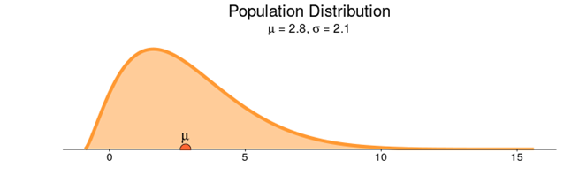
Problem 7.21a Shared Family Phone Plan
It is right skewed because 0 is a lower limit (can't have telephone calls of negative time)﻿, sigma is almost as large as mu and 0 is less than 1.33 sigma from the mu.

Slide 4
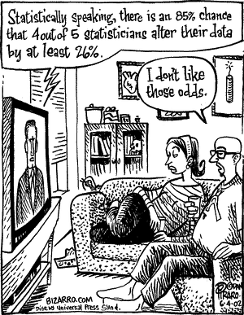
Review Chapter 8 - Statistical Inference: Confidence Intervals and T-Tests

Slide 5
Suppose we wish to use a sample to estimate the mean of a population
The sample mean will not necessarily be exactly the same as the population mean.
Imagine that we take a sample of 3 from a population of 10,000 observations

Slide 6
Pop: 10,000 people with equal numbers of individuals with values of 1,2,3,4,5,6,7,8,9,10
S1: 1,2,9 mean=4
S2: 5,4,9 mean=6
S3: 3,7,5 mean=5
S4: 1,1,2 mean=1.3
S5: 7,9,5 mean=7
And so forth μ=5.5

Slide 7
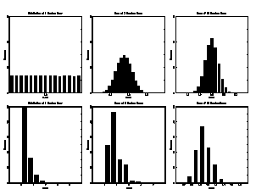
Distribution of Sample Mean by Sample Size
Column one shows the population distribution
Column two is the distribution of 3-draw means from column one;
Column three is the distribution of 30-draw means from column one.

Slide 8
Central Limit Theorem
As Sample Size Gets Large Enough
Sampling Distribution
Becomes
Almost Normal regardless of shape of population

Slide 9
Central Limit Theorem
For almost all populations, the sample mean is normally or approximately normally distributed, and the mean of this distribution is equal to the mean of the population and the standard deviation of this distribution can be obtained by dividing the population standard deviation by the square root of the sample size

Slide 10
If the original population is normal, a sample of only 1 observation is normally distributed
The further the original sample is from normal, the larger the sample required to approach normality
Even for samples that are far from normal a modest number of observations will be approximately normal

Slide 11
When the Population is Normal
Population Distribution
Central Tendency
μ
μ
_
=
x
Variation
σ
σ
Sampling Distributions
_
=
x
n = 4 σ_{‾X} = 5
n =16 σ_{‾X} = 2.5

Slide 12
When The Population is Not Normal
Population Distribution
Central Tendency
σ = 10
Variation
μ = 50
X
Sampling Distributions
n =30 σ_{‾X} = 1.8
n = 4 σ_{‾X} = 5
Note: n = 30

Slide 13
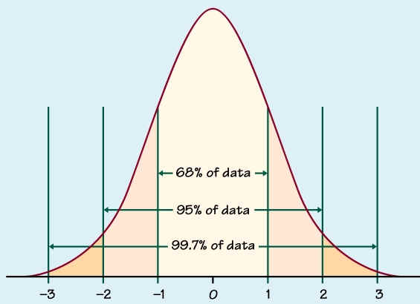
The Normal Distribution
Along the X axis you see Z scores, i.e. standardized deviations from the mean
Just think of Z scores as std. dev. denominated units.
A Z score tells us how many std. deviations an observation lies above or below the mean

Slide 14
The Normal Distribution
Note a property of the Normal distribution
68% of observations in a Normal distribution fall within 1 std. deviation of the mean
95% within 2 std. dev. (actually 1.96)
99.7% within 3 std. dev.
So what, you ask?

Slide 15
Welcome to Probability!
Probability is the likelihood of the occurrence of a single event
With just the mean and std. dev. of a (Normal) distribution we can make “inferences” using the Z score for any individual drawn randomly from the population.
E.g. Knowing that a salary survey of Americans reports a mean annual salary of 40,000 with a std. deviation of 10,000. What is the probability that a random person earns between 30K and 50K?
What’s the probability they earn over 50K? P(Z>=1) =15.87%

Slide 16
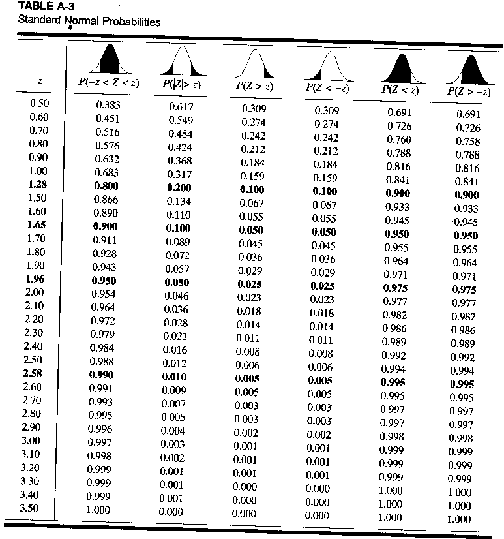
Fun with standard normal probabilities!
Problem :
you are 78 inches (6’6”) tall & bet a friend that you are the tallest person on campus. Campus heights in inches are ~N (64, 10). What’s the probability that you’re wrong?
interpolate
(78-64)/10 = 14/10=1.4

Slide 17
Confidence Intervals
We can use the Central Limit Theorem and the properties of the normal distribution to construct confidence intervals of the form:
The average salary is $40,000 plus or minus $1,000 with 95% confidence
Presidential support is 45% plus or minus 4% with 95% confidence.
In other words, we can make our best estimate using a sample and indicate a range of likely values for what we wish to estimate

Slide 18
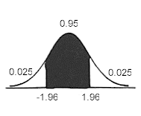

Confidence Intervals
Notice that our estimates of the population parameter are probabilistic.
So we report our sample statistic together with a measure of our (un)certainty
Most often, this takes the form of a 95 percent confidence interval establishing a boundary around the sample mean (x bar) which will contain the true population mean (μ) 95 out of 100 times.

Slide 19
Distribution of Confidence Intervals
Remember t value depends on confidence % and n
S1 $40,000±$10,000 or $30,000 to $50,000
95% of the intervals we could draw will contain the true mean μ
If we draw one sample, as we almost always do, the likelihood it will contain the true mean is .95

Slide 20
Confidence Intervals
Example: Randomly sampling 100 students for their GPA, you get a sample mean of 3.0 and a (pop) std. deviation of .4
What is the 95% confidence interval?
1. Calculate the standard deviation for
Calculate the lower confidence boundary: 3.0 – (1.96*0.04) = 2.92
Calculate the upper confidence boundary: 3.0 + (1.96*0.04) = 3.08
You are 95% confident that the interval 3.0 +/- .08 or 2.92 to 3.08 contains the true student population mean GPA.
With n = 100, we can use a Z value, i.e. 1.96
0.4/√100= 0.4/10=.04

Slide 21

Standard Errors from Samples
Of course, life is usually not so simple.
As undeniably cool as the Central Limit Theorem is, however, it has a problem:
We need to know σ
How often do researchers really know the population std (σ) deviation needed for calculating standard errors?
Thank Guinness for the solution…
Notation hint: population notation is mostly greek; sample latin.

Slide 22


How Guinness Saved the World
In the beginning of the 20th Century, a statistician at the Guinness Brewery in Dublin concerned with quality control came up with a solution
Calculate the standard deviation of the sample mean
and use Student’s t-distribution, which depends on sample size for inference.
Thank-you, Guinness!
William Gosset, a.k.a. “Student”

Slide 23
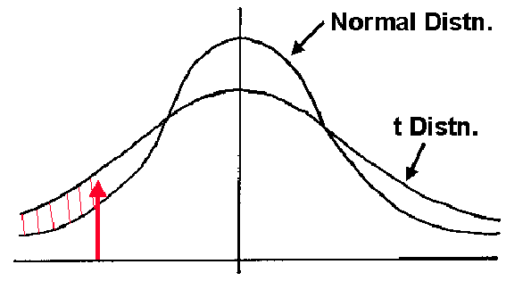
The t-distribution
For samples under 30 or so, the difference between the sample distribution s and the normal distribution σ can be large, the smaller the sample the larger the difference
Solution: The t-distribution is flatter than the Z distribution and gets increasingly so as the sample shrinks.
Thus, the smaller the sample the larger the interval necessary for a given level of confidence.
Small Sample? Hedge your bet!

Slide 24
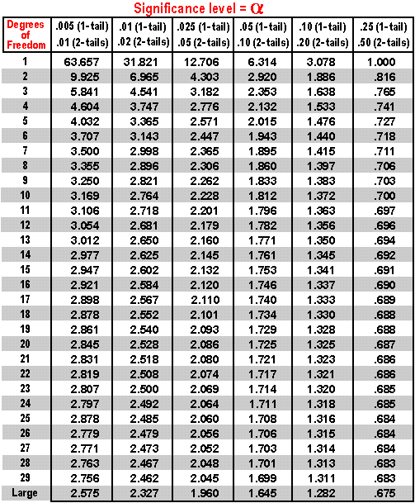
t-table
No longer can we assume that the pop mean (μ) will be within 1.96 std. deviations of the sample mean in 95 out of 100 samples.
The smaller the sample the more std. deviations we can expect μ can be from x-bar at a given level of confidence.
Degrees of freedom capture the sample size, In our observation= n - 1

Slide 25
Confidence Intervals w/out σ
Example: Randomly sampling 16 students for their GPA, you get a sample mean of 3.0 and sample std. deviation (s) of .4
Identify an interval which will contain the true population mean 95% of the time.
Calculate standard dev. of mean:
Calculate the interval 3 ±(2.132*.1)=3±.21 This is a confidence interval from 2.79 to 3.21. 95% of the time this interval will contain the mean.
If it were a known st. dev., σ, you would use the smaller value of z, 1.96 and the interval would be smaller: between 2.804 and 3.196.
From table on previous slide

Slide 26
Another example
Sample of 15 students slept an average of 6.4 hours last night with standard deviation of 1 hour.
Need t with n-1 = 15-1 = 14 d.f.
For 95% confidence, t₁₄ = 2.145
From table

Slide 27
What happens to CI as sample gets larger?
For large samples:
Z and t values become almost identical, so CIs are almost identical.

Slide 28
Section 9.1
Steps for Performing a Significance Test

Slide 29
Hypothesis
The main goal of many research studies is to check whether the data support certain statements or predictions. These statements are hypotheses about a population. They are usually expressed in terms of population parameters for variables measured in the study.
In statistics, a hypothesis is a statement about a population, usually claiming that a population parameter takes a particular numerical range of values.
Notes:
29

Slide 30
The Steps of a Significance Test
A significance test is a method of using data to summarize the evidence about a hypothesis.
A significance test about a hypothesis has five steps.
Assumptions
Hypotheses
Test Statistic
P-value
Conclusion
Notes:
30

Slide 31
Step 1: Assumptions
A significance test assumes that the data production used randomization.
Other assumptions may include:
Assumptions about the sample size.
Assumptions about the shape of the population distribution.
Notes:
31

Slide 32
Step 2: Hypothesis
Each significance test has two hypotheses:
The null hypothesis is a statement that the parameter takes a particular value. It has a single parameter value.
The alternative hypothesis states that the parameter falls in some alternative range of values.
Notes:
32

Slide 33
Null and Alternative Hypotheses
The value in the null hypothesis usually represents no effect.
The symbol H₀ denotes the null hypothesis.
The value in the alternative hypothesis usually represents an effect of some type.
The symbol H_{a} denotes the alternative hypothesis.
The alternative hypothesis should express what the researcher hopes to show. The hypotheses should be formulated before viewing or analyzing the data!
Notes:
33

Slide 34
Step 3: Test Statistic
A test statistic describes how far the point estimate falls from the parameter value given in the null hypothesis. Usually this distance is measured by the number of standard errors between the point estimate and the parameter.
Notes:
34

Slide 35
Step 4: P-value
To interpret a test statistic value, we use a probability summary of the evidence against the null hypothesis, H₀.
First, we presume that H₀ is true.
Then we consider the sorts of values we’d expect to get for the test statistic, according to its sampling distribution presuming H₀ is true.
Notes:
35

Slide 36
Step 4: P-value
We summarize how far out in the tail the test statistic falls by the tail probability of that value and values even more extreme.
This probability is called a P-value.
The smaller the P-value, the stronger the evidence is against H₀.
Notes:
36

Slide 37
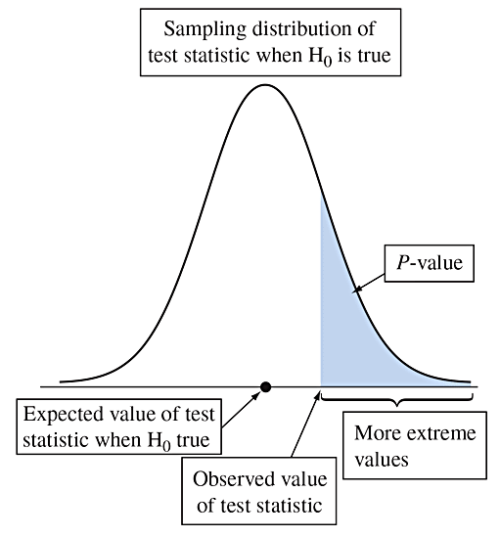
Step 4: P-value
Figure 9.1 Suppose H₀ Were True. The P-value Is the Probability of a Test Statistic Value Like the Observed One or Even More Extreme. This is the shaded area in the tail of the sampling distribution. Question Which gives stronger evidence against the null hypothesis, a P-value of 0.20 or of 0.01? Why?
Notes:
37

Slide 38
Step 4: P-value
The P-value is the probability that the test statistic equals the observed value or a value even more extreme.
It is calculated by presuming that the null hypothesis is true.
The smaller the P-value, the stronger the evidence the data provide against the null hypothesis. That is, a small P-value indicates a small likelihood of observing the sampled results if the null hypothesis were true.
Notes:
38

Slide 39
Step 5: Conclusion
The conclusion of a significance test reports the P-value and interprets what it says about the question that motivated the test.
Sometimes this includes a decision about the validity of the null hypothesis H₀.
Notes:
39

Slide 40

Lake Wobegone
Lake Wobegon is a fictional town created by Garrison Keillor as the setting of the "News from Lake Wobegon" segment of the radio program A Prairie Home Companion. Lake Wobegon is also the setting of many of Keillor's stories and novels. It is described as a small rural town in central Minnesota, and is peopled with fictional characters and places, many of which became familiar to listeners of the broadcast. The events and adventures of the townspeople provided Keillor with a wealth of humorous and often touching stories.^{[1][2]}

Slide 41

Lake Wobegone
Keillor's weekly monologue about Lake Wobegon included recurring elements:[5]
The opening words of the monologue usually were "Well, it's been a quiet week in Lake Wobegon, Minnesota, my hometown, out there on the edge of the prairie."
Lake Wobegon was called "the little town that time forgot and the decades cannot improve."
The closing words of the monologue were "Well, that's the news from Lake Wobegon, where all the women are strong, all the men are good-looking, and all the children are above average."

Slide 42

Problem 9.2 H₀ or H_{a}? Page 391
For each of the following, is the statement a null hypothesis or an alternative hypothesis? Why?
The mean IQ of all students at Lake Wobegone High School is higher than 100.
The probability of rolling a 6 with a particular die is 1/6.
The proportion of all new business enterprises that remain in business for at least 5 years is 0.50.
Answers:
alternative hypothesis
null hypothesis
alternative hypothesis
Average IQ

Slide 43
Section 9.2
Significance Tests About Proportions
Notes:
43

Slide 44
Example: Are Astrologers’ Predictions Better Than Guessing?
An astrologer prepares horoscopes for 116 adult volunteers. Each subject also filled out a California Personality Index (CPI) survey. For a given adult, his or her horoscope is shown to the astrologer along with their CPI survey as well as the CPI surveys for two other randomly selected adults. The astrologer is asked which survey is the correct one for that adult.
With random guessing, p = 1/3
The astrologers’ claim: p > 1/3
The hypotheses for this test:
Notes:
44

Slide 45

Problem 9.10 Psychic, page 405
A person who claims to be psychic says that the probability p that he can correctly predict the outcome of a flip of a fair coin will more often be right than wrong. If we want to test this claim, we could use the data from an experiment in which he predicts the outcomes for n flips of the coin. State the parameter of interest and the hypotheses for testing this claim, where the alternative hypothesis reflects the psychic’s claim.

Slide 46
Problem 9.10 Psychic, page 405
The parameter of interest is the proportion, p, of correct predictions of coin flips by psychic. The null hypothesis is that the psychic will successfully predict the outcome of the flip of a coin 1/2 of the time, and the alternative hypothesis is that the psychic will predict the outcome more than 1/2 of the time. H₀: p = 0.5; Ha: p > 0.5
or H₀: p = 1/2; Ha: p > 1/2

Slide 47
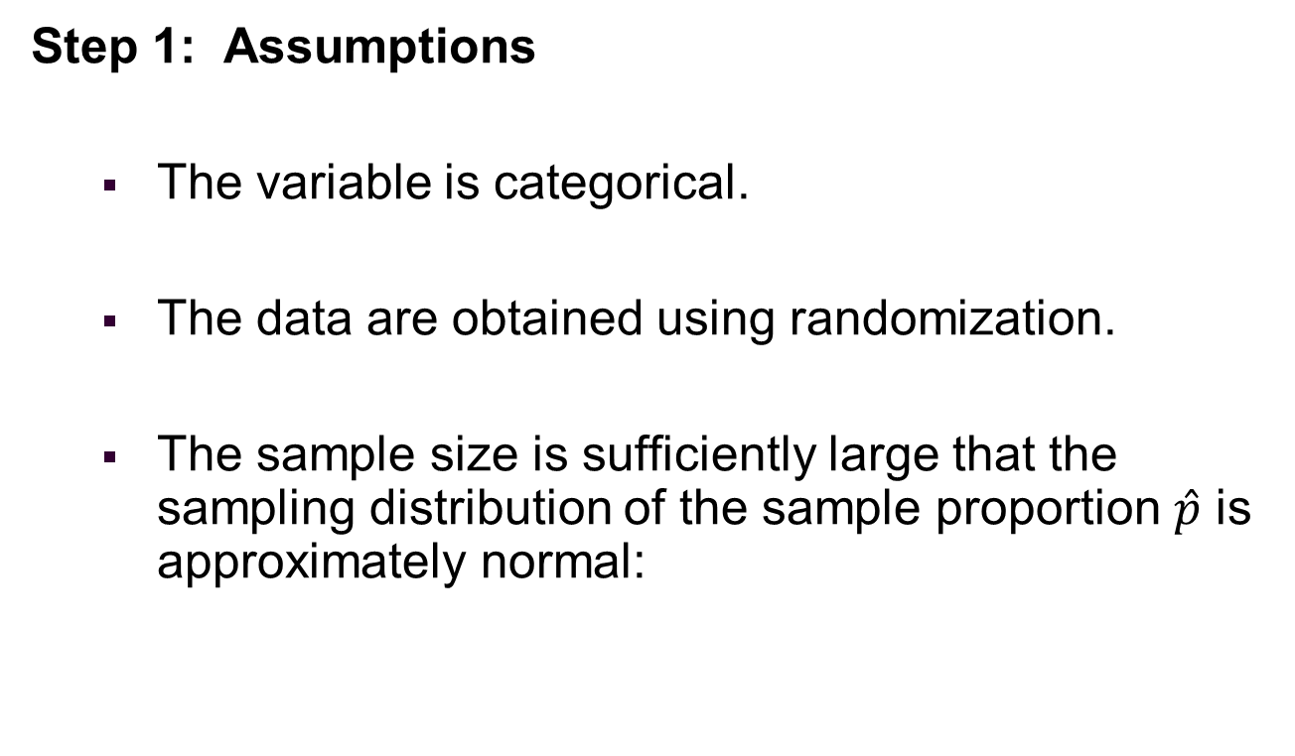
Steps of a Significance Test about a Population Proportion
Step 1: Assumptions
The variable is categorical.
The data are obtained using randomization.
The sample size is sufficiently large that the sampling distribution of the sample proportion $\hat{p}$ is approximately normal:
Notes:
47

Slide 48
Steps of a Significance Test about a Population Proportion
Step 2: Hypotheses
The null hypothesis has the form:
The alternative hypothesis has the form:
Notes:
48

Slide 49
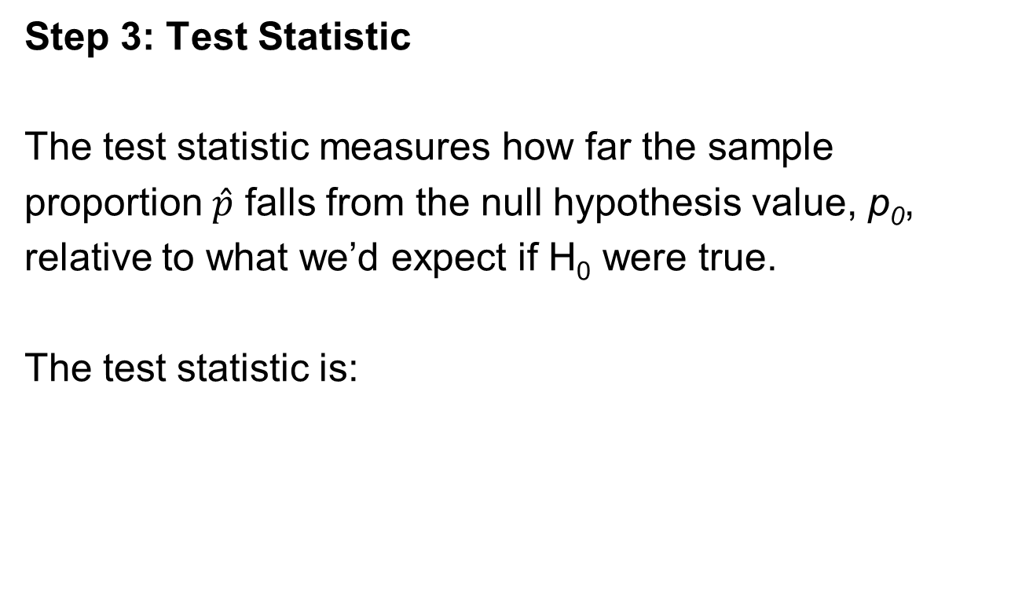
Steps of a Significance Test about a Population Proportion
Step 3: Test Statistic
The test statistic measures how far the sample
proportion $\hat{p}$ falls from the null hypothesis value, p₀,
relative to what we’d expect if H₀ were true.
The test statistic is:
Notes:
49

Slide 50
Steps of a Significance Test about a Population Proportion
Step 4: P-value
The P-value summarizes the evidence.
It describes how unusual the observed data would
be if H₀ were true.
If the P-value is small, we reject H₀.
KEY TAKEAWAYS
A p-value is a measure of the probability that an observed proportion could have occurred just by random chance.
The lower the p-value, the greater the statistical significance of the observed difference.
P-value can be used as an alternative to or in addition to pre-selected confidence levels for hypothesis testing.
Notes:
50

Slide 51
Steps of a Significance Test about a Population Proportion
Step 5: Conclusion
We summarize the test by reporting and interpreting the P-value.
Notes:
51

Slide 52
Example: Are Astrologers’ Predictions Better Than Guessing?
Step 1: Assumptions
The data is categorical – each prediction falls in the category “correct” or “incorrect”.
Each subject was identified by a random number. Subjects were randomly selected for each experiment.
Notes:
52

Slide 53
Example: Are Astrologers’ Predictions Better Than Guessing?
Step 2: Hypotheses
The null hypothesis has the form
The alternative hypothesis has the form
Notes:
53

Slide 54
Example: Are Astrologers’ Predictions Better Than Guessing?
Step 3: Test Statistic:
In the actual experiment, the astrologers were correct with 40 of their 116 predictions (a success rate of 0.345).
Notes:
54

Slide 55
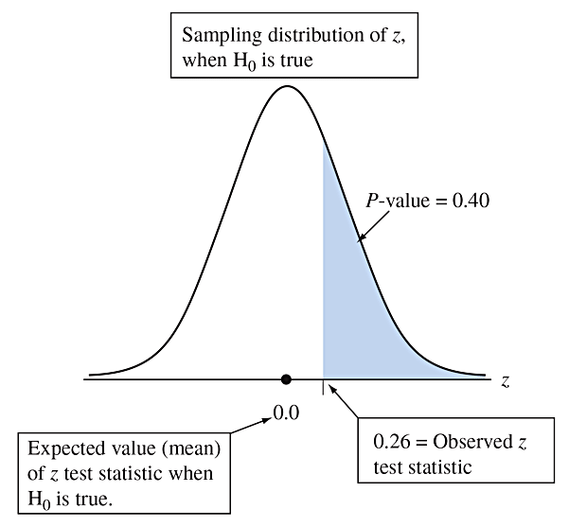
Example: Are Astrologers’ Predictions Better Than Guessing?
Step 4: P-value
The P-value of 0.40 tells us that if H₀ were true, the probability would be 0.40 that the test statistic would be as or more extreme than the observed value, i.e. could have occurred by random chance.
Figure 9.2 Calculation of P-value, When z = 0.26 for Testing H₀: p = 1/3 Against H_{a}: p > 1/3. Presuming that H₀ is true, the P-value is the right-tail probability of a test statistic value even more extreme than observed. Question Logically, why are the right-tail z -scores considered the more extreme values for testing H₀ against H_{a} :p > 1/3?
Notes:
55
We ask: “Does the sample give evidence against the null hypothesis?” P-value: The probability that the sample mean would take a value as extreme or more extreme than the one we actually observed assuming H0 is true.

Slide 56
Example: Are Astrologers’ Predictions Better Than Guessing?
Step 5: Conclusion
The P-value of 0.40 is not especially small.
It does not provide strong evidence against H₀:p = 1/3.
We do not reject H_{0.}
We would not conclude that astrologers have
special predictive powers.
Notes:
56

Slide 57

Interpreting the P-value
A significance test analyzes the strength of the evidence against the null hypothesis H₀.
We start by presuming that H₀ is true.
The burden of proof is on H_{a}.
Note that in our legal system, the burden of proof is on the prosecution.
Notes:
57

Slide 58
Interpreting the P-value
The approach used in hypothesis testing is called a proof by contradiction.
To convince ourselves that H_{a} is true, we must show that data contradict H₀, i.e. that the chance, that the observed data occurred randomly, is small.
If the P-value is small, the data contradict H₀ and support H_{a}.
Notes:
58

Slide 59
Two-Sided Significance Tests
A two-sided alternative hypothesis has the form
The P-value is the two-tail probability under the standard normal curve.
We calculate this by finding the tail probability in a single tail and then doubling it.
Notes:
59

Slide 60

Example: Dogs Detecting Cancer by Smell
Study:
Investigate whether dogs can be trained to distinguish a patient with bladder cancer by smelling compounds released in the patient’s urine.
Notes:
60

Slide 61
Example: Dogs Detecting Cancer by Smell
Experiment:
Each of 6 dogs was tested with 9 trials.
In each trial, one urine sample from a bladder cancer patient was randomly place among 6 control urine samples.
Notes:
61

Slide 62
Example: Dogs Detecting Cancer by Smell
Results:
In a total of 54 trials with the six dogs, the dogs made the correct selection 22 times (a success rate of 0.407).
Notes:
62

Slide 63
Example: Dogs Detecting Cancer by Smell
Question to Explore:
Does this study provide strong evidence that the dogs’ predictions were better or worse than with random guessing?
Notes:
63

Slide 64
Example: Dogs Detecting Cancer by Smell
Step 1: Check the sample size requirement:
Is the sample size sufficiently large to use the hypothesis test for a population proportion?
np₀ is not large enough.
We will see that the two-sided test is robust even when this assumption is not satisfied.
Notes:
64

Slide 65
Example: Dogs Detecting Cancer by Smell
Step 2: Hypotheses
Notes:
65

Slide 66
Example: Dogs Detecting Cancer by Smell
Step 3: Test Statistic
n
Notes:
66

Slide 67
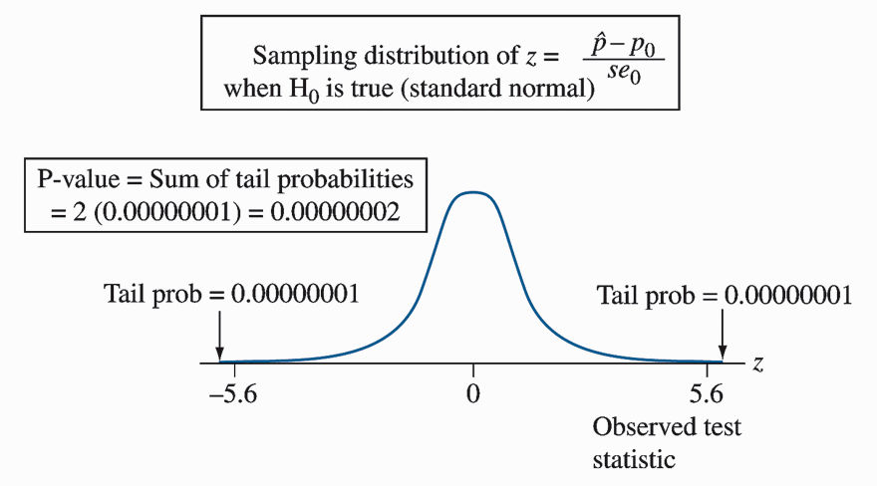
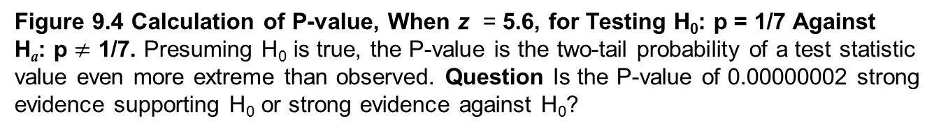
Example: Dogs Detecting Cancer by Smell
Step 4: P-value
Figure 9.4 Calculation of P-value, When z = 5.6, for Testing H₀: p = 1/7 Against H_{a}: p $≠$ 1/7. Presuming H₀ is true, the P-value is the two-tail probability of a test statistic value even more extreme than observed. Question Is the P-value of 0.00000002 strong evidence supporting H₀ or strong evidence against H₀?
Notes:
67

Slide 68
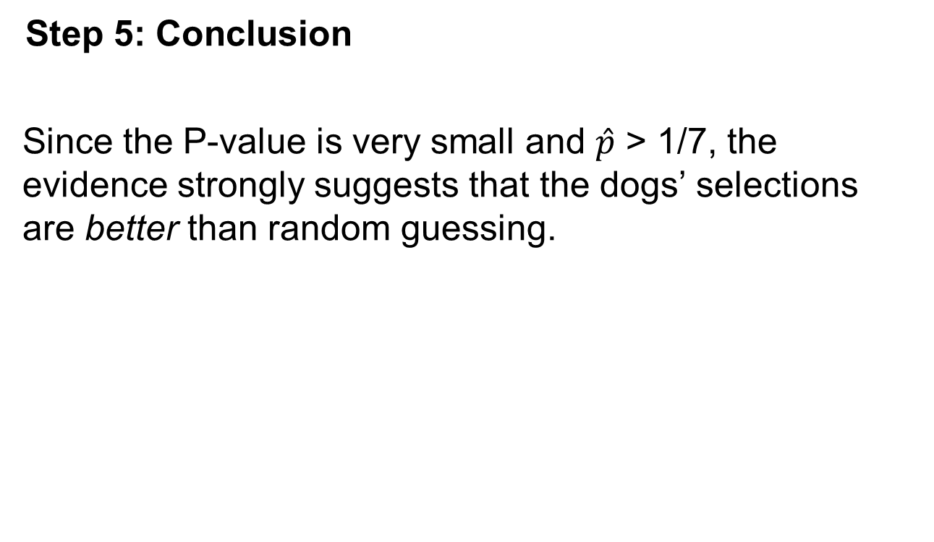
Example: Dogs Detecting Cancer by Smell
Step 5: Conclusion
Since the P-value is very small and $\hat{p}$ > 1/7, the evidence strongly suggests that the dogs’ selections are better than random guessing.
Notes:
68

Slide 69
Example: Dogs Detecting Cancer by Smell
Insight:
In this study, the subjects were a convenience sample rather than a random sample from some population.
Also, the dogs were not randomly selected.
Any inferential predictions are tentative. They are valid only to the extent that the patients and the dogs are representative of their populations.
The predictions become more conclusive if similar results occur in other studies.
Notes:
69

Slide 70

Scent dog identification of samples from COVID-19 patients – a pilot study’ https://bmcinfectdis.biomedcentral.com/articles/10.1186/s12879-020-05281-3
Abstract
Background
As the COVID-19 pandemic continues to spread, early, ideally real-time, identification of SARS-CoV-2 infected individuals is pivotal in interrupting infection chains. Volatile organic compounds produced during respiratory infections can cause specific scent imprints, which can be detected by trained dogs with a high rate of precision.
Methods
Eight detection dogs were trained for 1 week to detect saliva or tracheobronchial secretions of SARS-CoV-2 infected patients in a randomized, double-blinded and controlled study.
This Photo by Unknown Author is licensed under CC BY-SA

Slide 71
Scent dog identification of samples from COVID-19 patients – a pilot study’ https://bmcinfectdis.biomedcentral.com/articles/10.1186/s12879-020-05281-3
Results
The dogs were able to discriminate between samples of infected (positive) and non-infected (negative) individuals with average diagnostic sensitivity of 82.63% (95% confidence interval [CI]: 82.02–83.24%) and specificity of 96.35% (95% CI: 96.31–96.39%). During the presentation of 1012 randomized samples, the dogs achieved an overall average detection rate of 94% (±3.4%) with 157 correct indications of positive, 792 correct rejections of negative, 33 incorrect indications of negative or incorrect rejections of 30 positive sample presentations.
Conclusions
These preliminary findings indicate that trained detection dogs can identify respiratory secretion samples from hospitalized and clinically diseased SARS-CoV-2 infected individuals by discriminating between samples from SARS-CoV-2 infected patients and negative controls. This data may form the basis for the reliable screening method of SARS-CoV-2 infected people.

Slide 72
Dogs have two 'noses'
Dogs' powerful noses have 300 million sensors, compared with a human's measly 5 million. In addition, dogs have a second smelling device in the backs of their noses that we don't have, called Jacobson's organ.
That double smelling system allows trained dogs to detect cancer's unique odors, called volatile organic compounds.
It took humans thousands of years to figure this out. In 1989, doctors at King's College Hospital in London wrote in The Lancet about a woman whose dog persisted in smelling a particular mole on her leg. That mole turned out to be early-stage malignant melanoma.
Over the next 26 years, studies from France to California to Italy have concluded that dogs really can detect the smell of cancer.

Slide 73

Friends – nose to nose

Slide 74
Summary: P-values for Different Alternative Hypotheses
Alternative Hypothesis
P-value
Right-tail probability
Left-tail probability
Two-tail probability
Notes:
74

Slide 75
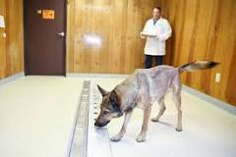
Problem 9.15 Dogs and Cancer, page 405
A recent study⁶ considered whether
dogs could be trained to detect if a person has lung cancer
or breast cancer by smelling the subject’s breath. The
researchers trained five ordinary household dogs to distinguish,
by scent alone, exhaled breath samples of 55 lung
and 31 breast cancer patients from those of 83 healthy
controls. A dog gave a correct indication of a cancer sample
by sitting in front of that sample when it was randomly
placed among four control samples. Once trained, the
dogs’ ability to distinguish cancer patients from controls
was tested using breath samples from subjects not previously
encountered by the dogs. (The researchers blinded
both dog handlers and experimental observers to the
identity of breath samples.) Let p denote the probability
a dog correctly detects a cancer sample placed among five
samples, when the other four are controls.
Humans can smell cancer through their own breath in later stages, so it makes sense that dogs can smell cancer in humans at stage zero. Stage zero cancer detection is an astonishing miracle, and to date, has only been accomplished by canines.

Slide 76
Problem 9.15 Dogs and Cancer, page 405
a. Set up the null hypothesis that the dog’s predictions
correspond to random guessing.
b. Set up the alternative hypothesis to test whether the
probability of a correct selection differs from random
guessing.
c. Set up the alternative hypothesis to test whether the
probability of a correct selection is greater than with
random guessing.
d. In one test with 83 Stage I lung cancer samples, the
dogs correctly identified the cancer sample 81 times.
The test statistic for the alternative hypothesis in
part c was z = 17.7. Report the P-value to three decimal
places, and interpret. (The success of dogs in this
study made researchers wonder whether dogs can
detect cancer at an earlier stage than conventional
methods such as MRI scans.)

Slide 77
Problem 9.15 Dogs and Cancer, page 405
Humans can smell cancer through their own breath in later stages, so it makes sense that dogs can smell cancer in humans at stage zero. Stage zero cancer detection is an astonishing miracle, and to date, has only been accomplished by canines.
H₀: p = 1/5
Ha: p = 1/5
Ha: p > 1/5
se₀ ₌ √p₀ ( 1 – p₀)/ n = √0.2 ( 1 – 0.2)/ 83 = 0.043
z = (p^ - p₀) / se₀ = (81/83 – 1/5)/ 0.043 = 18.04
P-value ~ 0.000. The probability of obtaining a sample proportion of 81 or more successes in 83 trials is essentially 0; thus, there is strong evidence that the probability of a correct selection is greater than with random guessing.

Slide 78
The Significance Level Tells Us How Strong the Evidence Must Be
Sometimes we need to make a decision about whether the data provide sufficient evidence to reject H₀.
Before seeing the data, we decide how small the P-value would need to be to reject H₀.
This cutoff point is called the significance level.
Notes:
78

Slide 79
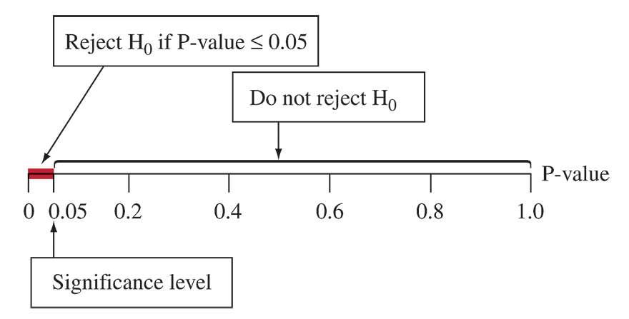
The Significance Level Tells Us How Strong the Evidence Must Be
Figure 9.5 The Decision in a Significance Test. Reject H₀ if the P-value is less than or
equal to a chosen significance level, usually 0.05.
Notes:
79

Slide 80
Significance Level
The significance level is a number such that we reject H₀ if the P-value is less than or equal to that number.
In practice, the most common significance level is 0.05.
When we reject H₀, we say the results are statistically significant.
Notes:
80

Slide 81
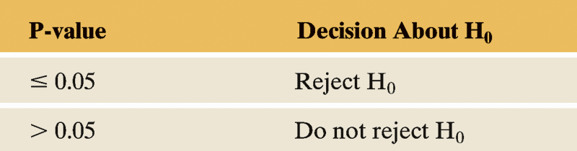
Possible Decisions in a Test of Significance
Table 9.1 Possible Decisions in a Test of Significance.
Notes:
81

Slide 82

Report the P-value
Learning the actual P-value is more informative than learning only whether the test is “statistically significant at the 0.05 level.”
The P-values of 0.001 and 0.049 are both statistically significant in this sense, but the first P-value provides much stronger evidence that the result is statistically significant than the second P-value.
This Photo by Unknown Author is licensed under CC BY-SA
Notes:
82

Slide 83
Problem 9.20 Gender Bias in Selecting Managers, page 406
For a large supermarket chain in Florida, a women’s group claimed that female employees were passed over for management training in favor of their male colleagues. The company denied this claim, saying they picked the employees from the eligible pool at random to receive this training. Statewide, the large pool of more than 1000 eligible employees who can be tapped for management training is 40% female and 60% male. Since this program began, 28 of the 40 employees chosen for management training were male and 12 were female.

Slide 84
Problem 9.20 Gender Bias in Selecting Managers, page 406
a. The company claims that it selected employees for training according to their proportion in the pool of eligible employees. Define a parameter of interest and state this claim as a hypothesis.
b. State the null and alternative hypotheses for a test to investigate the strength of evidence to support the women’s claim. (Hint: Gender bias means that either males or females are disproportionally selected.)
c. The table shows results of using StatCrunch to do a
large-sample analysis. Explain why the large-sample
analysis is justified, and show how software obtained
the test statistic value.

Slide 85
Problem 9.20 Gender Bias in Selecting Managers, page 406
Test of p = 0.60 vs. not = 0.60
X N Sample p 95.0% CI Z-Value P-Value
28 40 0.70000 (0.558,0.842) 1.29 0.1967
d. To what alternative hypothesis does the P-value in
the table refer? Use it to find the P-value for the
alternative hypothesis you specified in part a, and
interpret it.
e. What decision would you make for a 0.05 significance
level? Interpret.

Slide 86
Problem 9.20 Gender Bias in Selecting Managers, page 406
and b) Let p be the probability that the company selects a female (H₀ : p = 0.4). No effect here means a probability of selecting females that is in accordance with the proportion of eligible females. (Note: It is also correct to let p be the probability of selecting a male (H₀ : p = 0.6).
c) There is a gender bias if p is different (i.e., either smaller or larger) than 0.4, so we test H₀ : p = 0.4 and H_{α} : p = 0.4. (Or, if p was selected as the probability of selecting a male in (a), then we have H₀ : p = 0.6 and H_{α} : p = 0.6. )
The large-sample analysis is justified because the expected successes and failures are both at least fifteen under H₀, np₀ = 40(0.4) = 16 ≥15 and n(1-p₀) = 40(0.6) = 24≥15.
pˆ =12 / 40 = 0.30; The standard error is
√p₀ ( 1 – p₀)/ n = √0.4 ( 1 – 0.4)/ 40 = 0.077
so z = (0.3 – 0.4) / 0.077 = -1.29.

Slide 87
Problem 9.20 Gender Bias in Selecting Managers, page 406 (continued)
The P-value in the table refers to the alternative hypothesis (H_{α} : p = 0.4). (Note: If you chose p as the probability of selecting a male in (a) and tested the alternative (H_{α} : p = 0.6), it will have the same P-value.) The P-value of 0.1967 is large. The sample proportion of 0.3 falls not too far (1.29 standard errors) from the hypothesized value of 0.4, indicating no unusual data in light of the null hypothesis. If the null-hypothesis were true, observing a test statistic (or sample proportion) this extreme or even more extreme is not that unlikely (19.7%).
Because the P-value of 0.1967 is larger than the significance level, we would not reject the null hypothesis. There is insufficient evidence that the proportion of females selected for management training is different from the proportion of 40% eligible for that training

Slide 88
“Do Not Reject H₀” Is Not the Same as Saying “Accept H₀”
Analogy: Courtroom trial
Null Hypothesis: Defendant is innocent.
Alternative Hypothesis: Defendant is guilty.
If the jury acquits the defendant, this does not mean that it accepts the defendant’s claim of innocence.
Innocence is plausible because guilt has not been established beyond a reasonable doubt.
Notes:
88

Slide 89
Deciding between a One-Sided and a Two-Sided Test?
Things to consider in deciding on the alternative hypothesis:
The context of the real problem.
In most research articles, significance tests use two-sided P-values.
Confidence intervals are two-sided.
Notes:
89

Slide 90
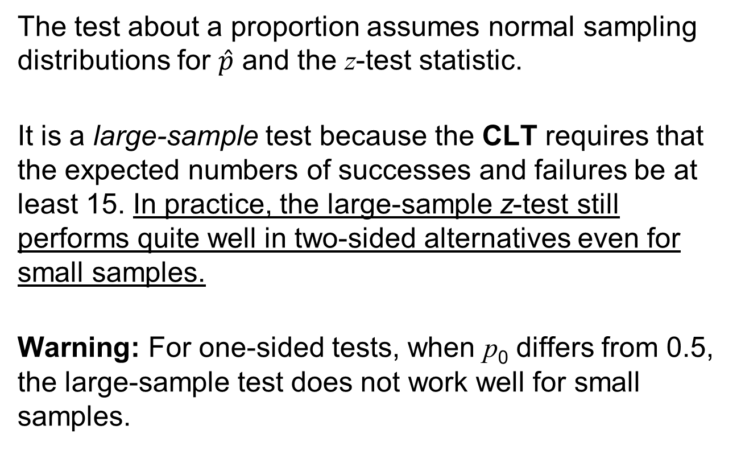
The Binomial Test for Small Samples
The test about a proportion assumes normal sampling distributions for $\hat{p}$ and the z-test statistic.
It is a large-sample test because the CLT requires that the expected numbers of successes and failures be at least 15. In practice, the large-sample z-test still performs quite well in two-sided alternatives even for small samples.
Warning: For one-sided tests, when p₀ differs from 0.5, the large-sample test does not work well for small samples.
Notes:
90

Slide 91
Section 9.3
Significance Tests About Means
Notes:
91

Slide 92
Steps of a Significance Test About a Population Mean
Step 1: Assumptions
The variable is quantitative.
The data production employed randomization.
The population distribution is approximately normal. This is most crucial when n is small and is H_{a} one-sided.
Notes:
92

Slide 93
Steps of a Significance Test About a Population Mean
Step 2: Hypotheses:
The null hypothesis has the form:
The alternative hypothesis has the form:
Notes:
93

Slide 94
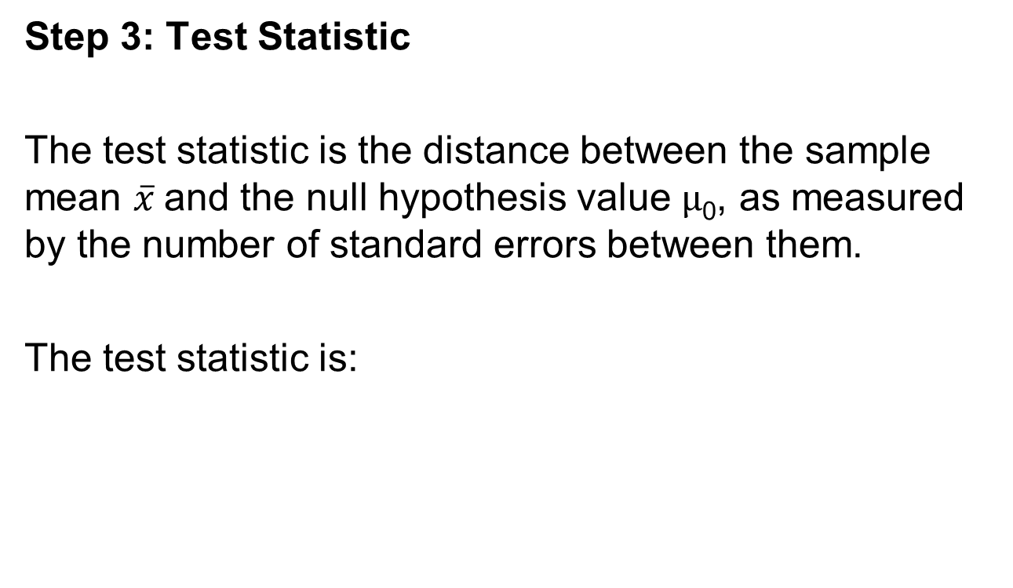
Steps of a Significance Test About a Population Mean
Step 3: Test Statistic
The test statistic is the distance between the sample mean $\overline{x}$and the null hypothesis value $μ$₀, as measured by the number of standard errors between them.
The test statistic is:
Notes:
94

Slide 95
Steps of a Significance Test About a Population Mean
Step 3: Test Statistic
When H₀ is true, the t test statistic has approximately the t distribution. The t distribution is specified by its degrees of freedom, which equal n – 1 for inference about a mean. This test statistic is called a t statistic.
Notes:
95

Slide 96
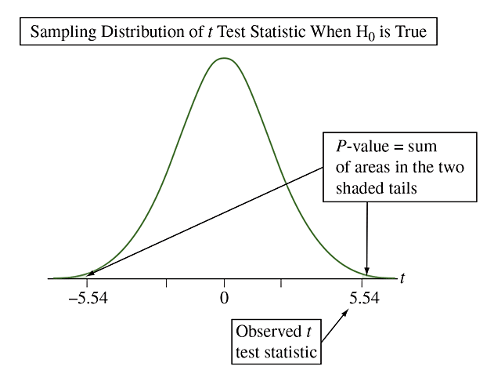
Steps of a Significance Test About a Population Mean
Step 3: Test Statistic
Figure 9.6 The t Distribution of the t Test Statistic. The t distribution looks like the
standard normal but has more variability, i.e., fatter tails. There is stronger evidence against
H₀ when the t test statistic falls farther out in a tail. The P-value for a two-sided H_{a} is a two-tail
probability (shaded in figure). Question Why is it that t-scores farther out in the tails provide
stronger evidence against H₀?
Notes:
96

Slide 97
Steps of a Significance Test About a Population Mean
Step 4: P-value
The P-value summarizes the evidence.
It describes how unusual the data would be if H₀ were true. That is, a small P-value indicates a small likelihood of observing the sampled results if the null hypothesis were true. Said another way, a p-value is a measure of the probability that an observed mean could have occurred just by random chance.
Notes:
97

Slide 98
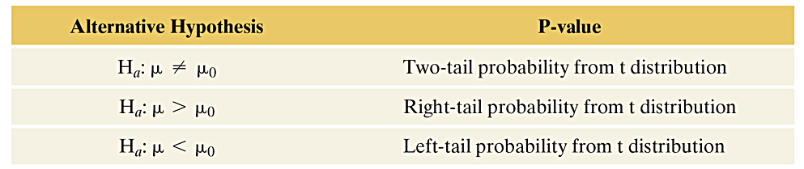
Summary of P-values for Different Alternative Hypotheses
The P-value is a single tail or a two-tail probability depending on whether the alternative hypothesis is one-sided or two-sided.
Notes:
98

Slide 99
Steps of a Significance Test About a Population Mean
Step 5: Conclusion
The conclusion of a significance test reports the P-value and interprets what it says about the question that motivated the test.
Notes:
99

Slide 100
Chapter 9
Statistical Inference: Significance Tests About Hypotheses

Slide 101
Problem 9.32 Female Work Week, page 417
When the 583 female workers in the 2012 GSS were asked how many hours they worked in the previous week, the mean was 37.0 hours with a standard deviation of 15.1 hours. Does this suggest that the population mean work week for females is significantly different from 40 hours? Answer by:
Identifying the relevant variable and parameter.
Stating null and alternative hypotheses.
Reporting an interpreting the P-value for the test-statistic value.
Explaining how to make a decision for the significance level of 0.01.

Slide 102
Problem 9.32 Female Work Week, page 417
a) The relevant variable is the number of hours worked by females in the previous week; the parameter of interest is the mean number of hours, μ , worked by females in the United States in the previous week.
b) H₀: μ = 40; Ha : μ = 40
c) t = (37.0 – 40)/ (15.1/√583) = -4.8; P-value ~ 0. The P-value is the probability of observing a test statistic this extreme or even more extreme (equivalently, a sample mean this far away from the null value of 40 or even further away, in both directions) when the P-value is very small (less than 0.1%), the null hypothesis is rejected.
d) Because the P-value is less than the significance level of 0.01, we have sufficient evidence to reject the null hypothesis and conclude that the mean working week for females in the United States is different from 40 hours.

Slide 103

Life Balance

Slide 104
Example: Mean Weight Change in Anorexic Girls
A study compared different psychological therapies for teenage girls suffering from anorexia.
The variable of interest was each girl’s weight change: weight at the end of the study minus weight at the beginning of the study.
The weight change was positive if the girl gained weight and negative if she lost weight.
Notes:
104

Slide 105
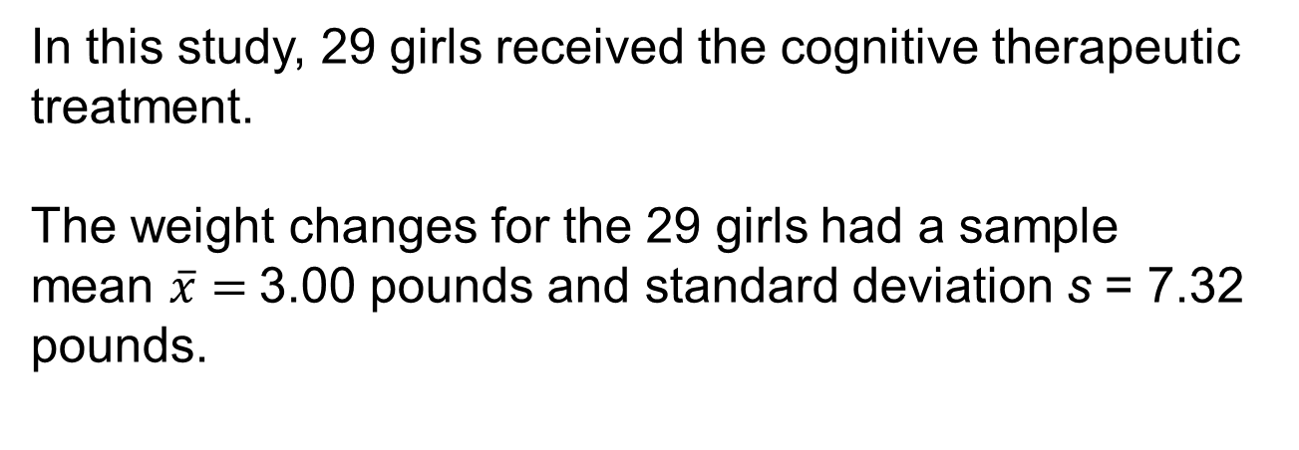
Example: Mean Weight Change in Anorexic Girls
In this study, 29 girls received the cognitive therapeutic treatment.
The weight changes for the 29 girls had a sample
mean $\overline{x}=$3.00 pounds and standard deviation s = 7.32 pounds.
Notes:
105

Slide 106
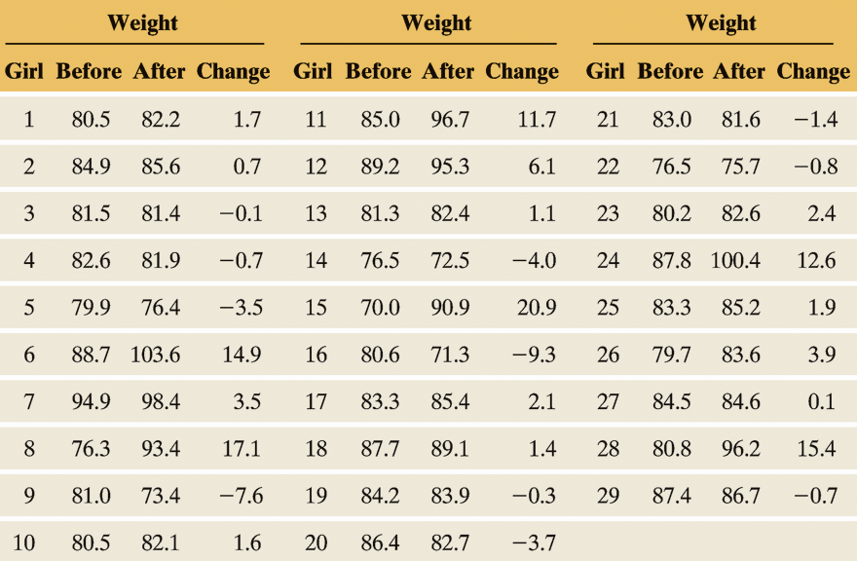
Example: Mean Weight Change in Anorexic Girls
Table 9.4 Weights of Anorexic Girls (in Pounds) Before and After Treatment
This example uses the weight change as the variable of interest.
Notes:
106

Slide 107
Example: Mean Weight Change in Anorexic Girls
How can we frame this investigation in the context of a significance test that can detect whether the therapy was effective?
Null hypothesis: “no effect”
Alternative hypothesis: therapy is “effective”
Notes:
107

Slide 108
Example: Mean Weight Change in Anorexic Girls
Step 1: Assumptions
The variable (weight change) is quantitative.
The subjects were a convenience sample, rather than a random sample. The question is whether these girls are a good representation of all girls with anorexia.
The population distribution is approximately normal.
Notes:
108

Slide 109
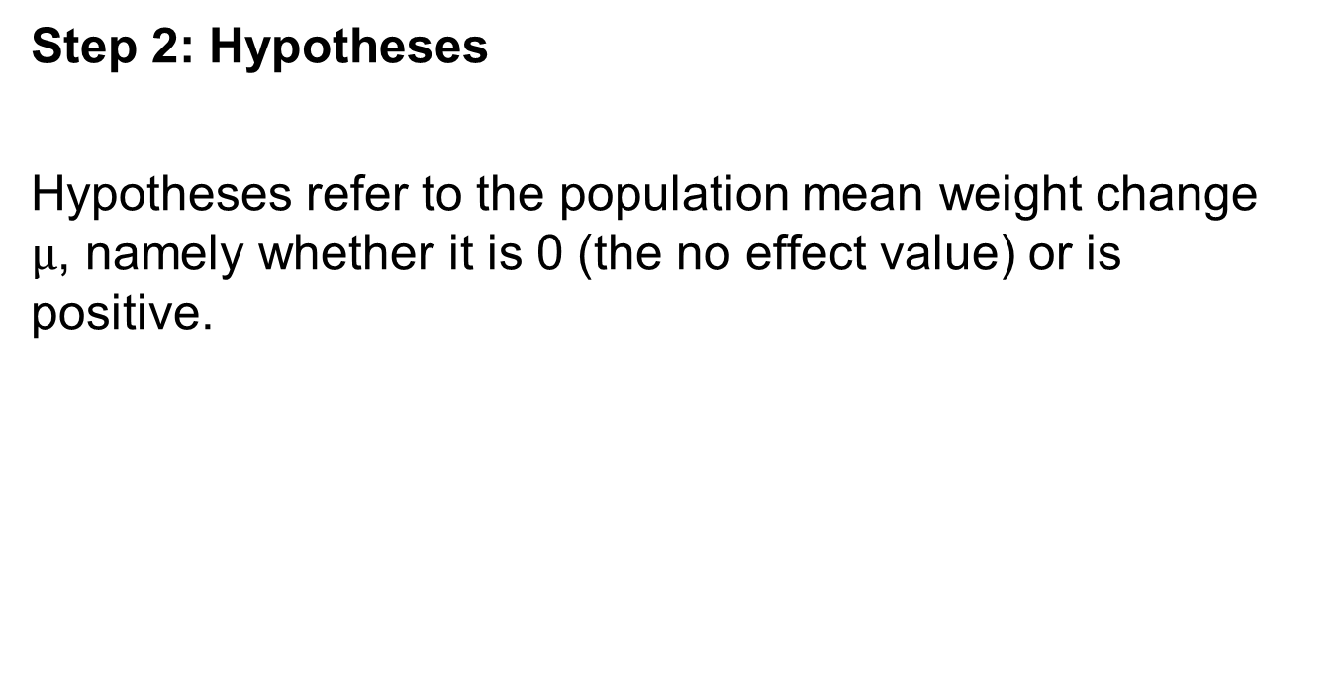
Example: Mean Weight Change in Anorexic Girls
Step 2: Hypotheses
Hypotheses refer to the population mean weight change $μ$, namely whether it is 0 (the no effect value) or is positive.
Notes:
109

Slide 110
Example: Mean Weight Change in Anorexic Girls
Step 3: Test Statistic
Notes:
110

Slide 111
Example: Mean Weight Change in Anorexic Girls
Step 4: P-value
The P-value is the area to the right of t = 2.21 for the t distribution with 28 df. This value is 0.018.
If the treatment had no effect, the probability of obtaining a sample this extreme would be 0.018.
Notes:
111

Slide 112
Example: Mean Weight Change in Anorexic Girls
Step 5: Conclusion
The small P-value of 0.018 provides considerable evidence against the null hypothesis (the hypothesis that the therapy had no effect).
Notes:
112

Slide 113
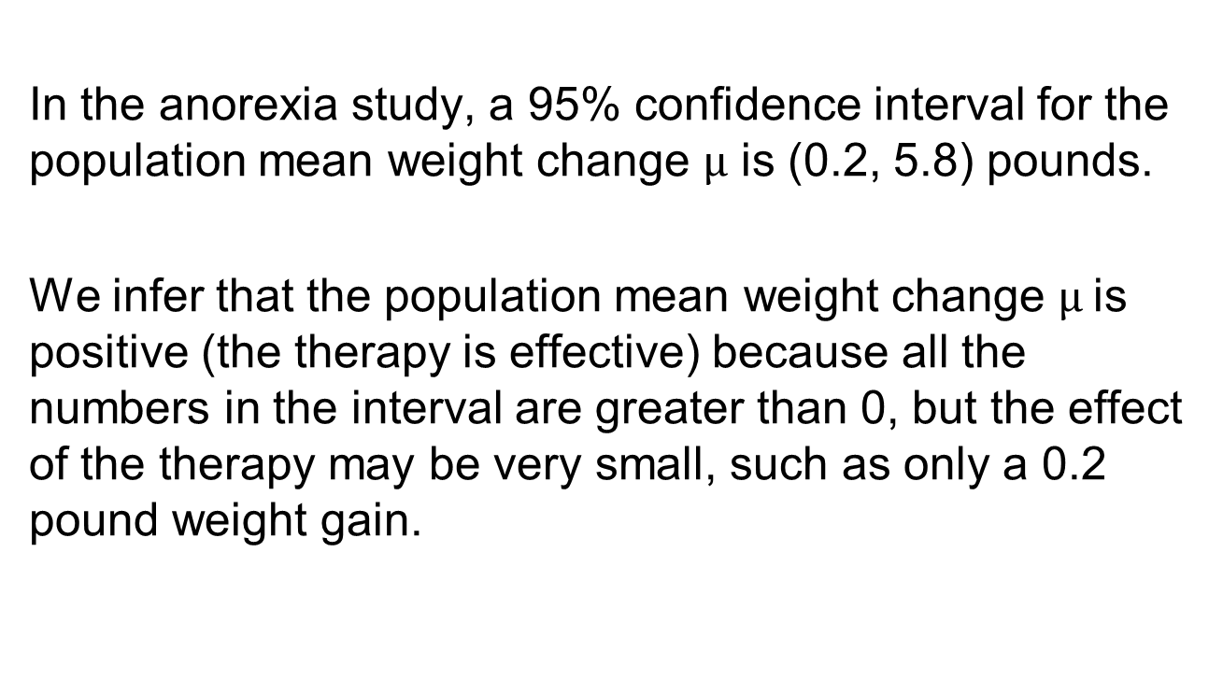
Results of two-sided tests and confidence intervals agree
In the anorexia study, a 95% confidence interval for the population mean weight change $μ$ is (0.2, 5.8) pounds.
We infer that the population mean weight change $μ$is positive (the therapy is effective) because all the numbers in the interval are greater than 0, but the effect of the therapy may be very small, such as only a 0.2 pound weight gain.
Notes:
113

Slide 114
9.29 Practice mechanics of a t test, page 416
A study has a random sample of 20 subjects. The test statistic for testing H0: μ=100 is t = 2.40. Find the approximate P-value for the alternative,
Ha: μ ≠ 100,
(b) Ha: μ > 100 , and
(c) Ha: μ < 100.

Slide 115
9.29 Practice mechanics of a t test, page 416
A study has a random sample of 20 subjects. The test statistic for testing H₀: μ = 100 is t = 2.40.
The P-value is the area to the right, left or on both sides of t = 2.40 for the t distribution with 20-1=19 df. Find the approximate P-value for the alternative
a) H_{a}: μ = 100 P-value is 0.026 or 0.03
b) H_{a}: μ > 100 P-value is 0.013
c) H_{a}: μ < 100 P-value is 0.987
MyLabStat/Pearson → Tools for Success → Web Apps
→ t Distribution → Find Probability
https://istats.shinyapps.io/tdist/

Slide 116
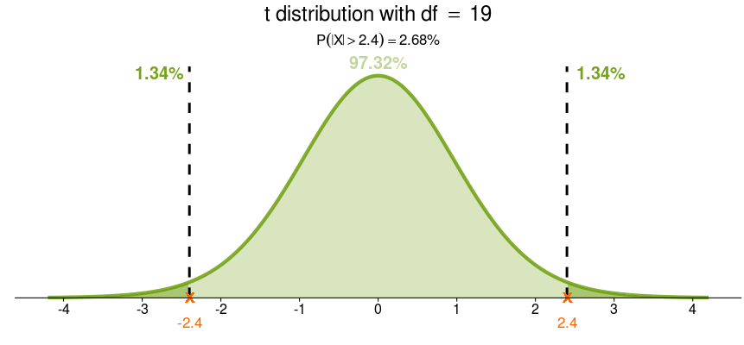
t Distribution with df = 19, P(X>2.4)

Slide 117
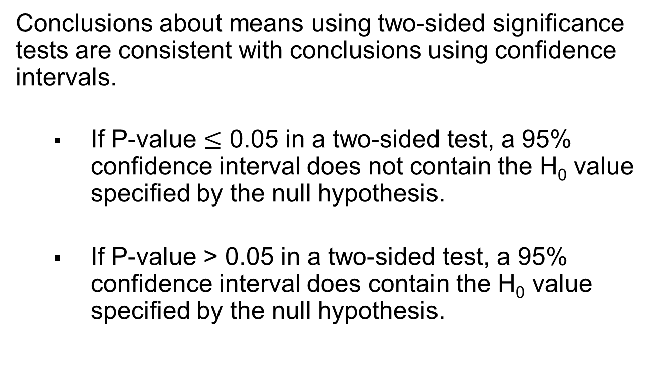
Results of Two-Sided Tests and Results of Confidence Intervals Agree
Conclusions about means using two-sided significance tests are consistent with conclusions using confidence intervals.
If P-value $≤$ 0.05 in a two-sided test, a 95% confidence interval does not contain the H₀ value specified by the null hypothesis.
If P-value > 0.05 in a two-sided test, a 95% confidence interval does contain the H₀ value specified by the null hypothesis.
Notes:
117

Slide 118
Problem 9.31 Low Carbohydrate Diet
In a recent study,⁸ 272 moderately obese subjects were randomly assigned to one of three diets: low-fat, restricted-calorie; Mediterranean, restricted calorie; or low-carbohydrate, non-restricted- calorie. The prediction was that subjects on a low- carbohydrate diet would lose weight, on the average. After two years, the mean weight loss was 5.5 kg for the 109 subjects in the low carbohydrate group with a standard deviation of 7.0kg. The MINITAB/STATCRUNCH output shows results of a significance test for testing H₀: μ = 0 against H_{a}: μ ≠ 0, where μ is the population mean weight change. Note that weight change is determined by calculating after weight - before weight.

Slide 119
Problem 9.31 Low Carbohydrate Diet
a. Identify the P-value for this test.
b. How is the P-value interpreted?
c. Would the P-value and 95% confidence interval lead to
the same conclusion about H₀? Explain.

Slide 120
Problem 9.31 Low Carbohydrate Diet
Minitab/ StatCrunch Output
a) P-value ~ 0
b) The P-value is interpreted as the proportion of samples that would have a test statistic value at least as extreme as –8.2 (in either direction), given that the null hypothesis is true.
c) Yes, both the P-value and the 95% confidence interval led to the same conclusion about H₀, namely, to reject in favor of the alternative. At approximately 0, the P-value is below any reasonable significance level for the test. The confidence interval does not contain the hypothesized value of 0, indicating that the null hypothesis should be rejected in favor of the alternative.
n | Mean | StDev | SE Mean | 95% CI | t | P
109 | -5.500 | 7.000 | 0.670 | (-6.829, -4.171) | -8.20 | 0.000

Slide 121
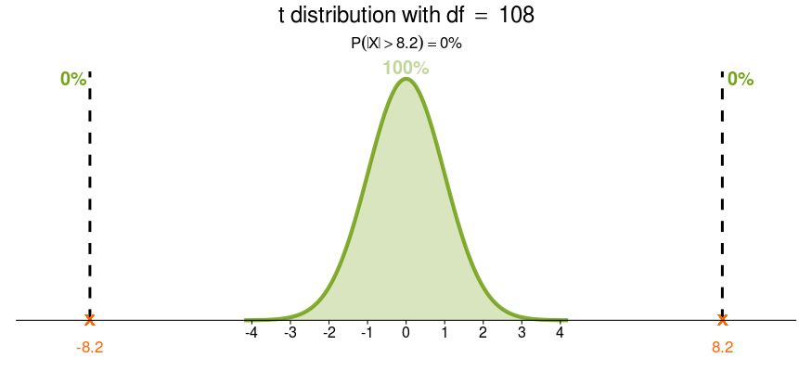
t Distribution with df = 108, P(|X|<8.2)

Slide 122
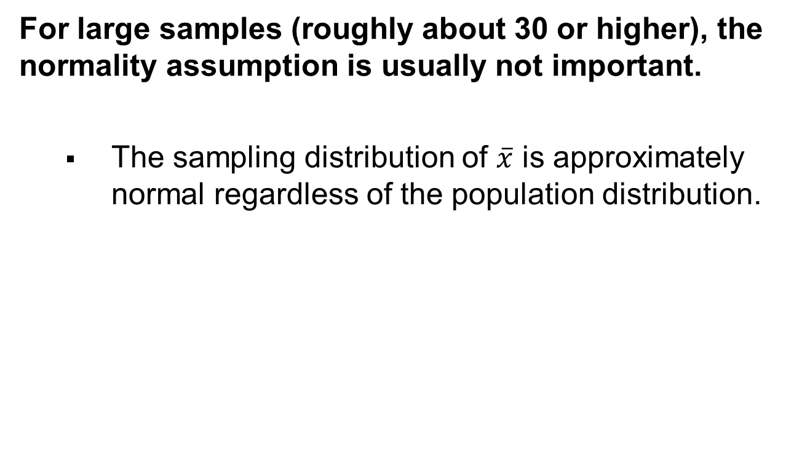
When the Population Does Not Satisfy the Normality Assumption
For large samples (roughly about 30 or higher), the normality assumption is usually not important.
The sampling distribution of $\overline{x}$ is approximately normal regardless of the population distribution.
Notes:
122

Slide 123
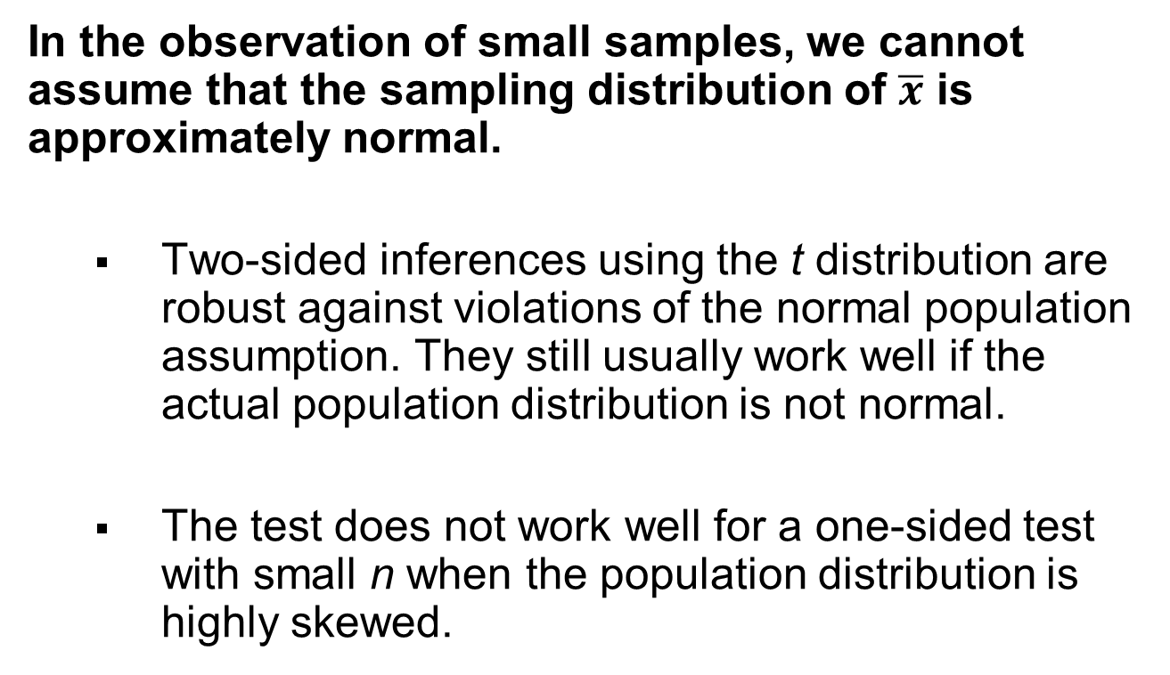
When the Population Does Not Satisfy the Normality Assumption
In the observation of small samples, we cannot assume that the sampling distribution of $\overline{x}$ is approximately normal.
Two-sided inferences using the t distribution are robust against violations of the normal population assumption. They still usually work well if the actual population distribution is not normal.
The test does not work well for a one-sided test with small n when the population distribution is highly skewed.
Notes:
123

Slide 124
Regardless of Robustness, Look at the Data
Whether n is small or large, you should look at the data to check for severe skew or for outliers that occur primarily in one direction.
They could cause the sample mean to be a misleading measure.
Notes:
124

Slide 125
Section 9.4
Decisions and Types of Errors in Significance Tests
Notes:
125

Slide 126
Type I and Type II Errors
When H₀ is true, a Type I Error occurs when H₀ is rejected. (a false positive)
When H₀ is false, a Type II Error occurs when H₀ is not rejected. (a false negative)
As P(Type I Error) goes Down, P(Type II Error) goes Up.
The two probabilities are inversely related.
Notes:
126

Slide 127
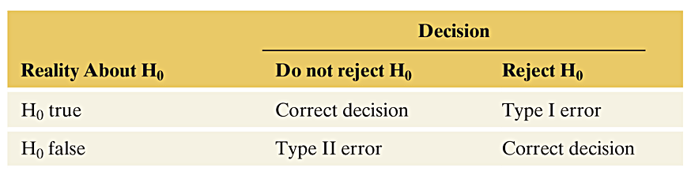
Significance Test Results
Table 9.5 The Four Possible Results of a Decision in a Significance Test. Type I and Type II errors are the two possible incorrect decisions. We make a correct decision if we do not reject H₀ when it is true or if we reject it when it is false.
Notes:
127

Slide 128
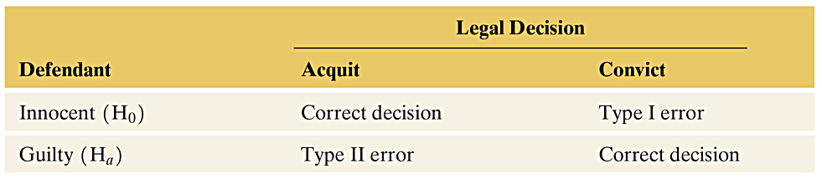
Significance Test Results
Table 9.6 Possible Results of a Legal Trial
In the jury trial there are two types of errors: (1) the person is innocent but the jury finds the person guilty, and (2) the person is guilty but the jury declares the person to be innocent. In our system of justice, the first error is considered more serious than the second error. These two errors along with the correct decisions are shown in the next table where the jury decision is shown on the left margin and the true state of affairs is shown along the top margin of the table.
 | Truth is Person Innocent | Truth is Person Guilty
Jury Decides Person Innocent | Correct Decision | Type II Error
Jury Decides Person Guilty | Type I Error | Correct Decision
That it is better 100 guilty Persons should escape than that one innocent Person should suffer, is a Maxim that has been long and generally approved. ATTRIBUTION: BENJAMIN FRANKLIN, letter to Benjamin Vaughan, March 14, 1785
Notes:
128

Slide 129

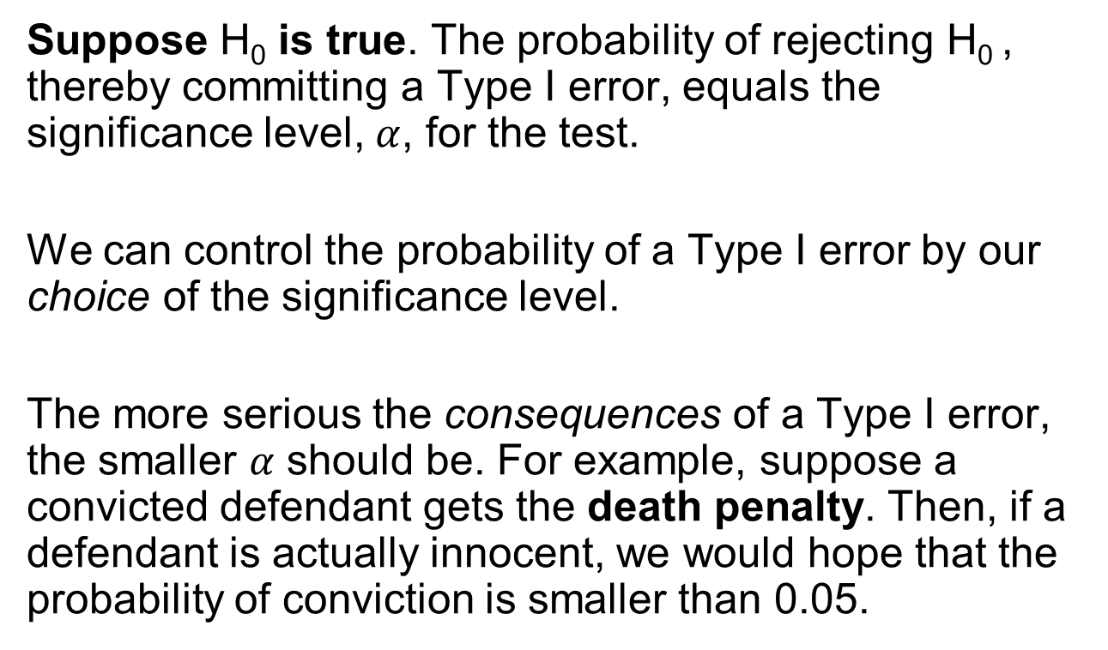
P(Type I Error) = Significance Level $α$
Suppose H₀ is true. The probability of rejecting H₀ , thereby committing a Type I error, equals the significance level, $α$, for the test.
We can control the probability of a Type I error by our choice of the significance level.
The more serious the consequences of a Type I error, the smaller $α$ should be. For example, suppose a convicted defendant gets the death penalty. Then, if a defendant is actually innocent, we would hope that the probability of conviction is smaller than 0.05.
Notes:
129

Slide 130
Problem 9.50 part c - Decision errors in medical diagnostic testing, page 423
Consider medical diagnostic testing, such as using a mammogram to detect if a woman may have breast cancer.
Define the null hypothesis of no effect as the patient does not have the disease. Define rejecting H₀ as concluding that the patient has the disease. See the table for a summary of the
possible outcomes:
Medical Diagnostic Testing
Medical Diagnosis
Disease Negative Positive
No (H0 ) Correct Type I error
Yes (Ha ) Type II error Correct

Slide 131
Problem 9.50 part c - Decision errors in medical diagnostic testing, page 423
a. When a radiologist interprets a mammogram, explain
why a Type I error is a false positive, predicting that a
woman has breast cancer when actually she does not.
b. A Type II error is a false negative. What does this
mean, and what is the consequence of such an error to
the woman?
c. A radiologist wants to decrease the chance of telling
a woman that she may have breast cancer when actually
she does not. Consequently, a positive test result
will be reported only when there is extremely strong
evidence that breast cancer is present. What is the disadvantage
of this approach?

Slide 132
Problem 9.50 part c - Decision errors in medical diagnostic testing, page 423
Medical Diagnostic Testing
Medical Diagnosis
Disease | Negative | Positive
No ( H₀) | Correct | Type I Error
Yes (H_{a}) | Type II Error | Correct
For Part c, the researcher wants to decrease the chance of making a Type I Error, i.e. telling a patient that she has breast cancer when she actually does not. So, the researcher decreases the significance level, α, from say, 0.05 to 0.01, i.e. the probability of incorrectly rejecting H₀.

Slide 133
Problem 9.50 part c - Decision errors in medical diagnostic testing, page 423
a) A Type I error is a false positive because we have rejected the null hypothesis that there is no disease, but we were wrong. The woman in fact does not have breast cancer. The consequence would be that the woman would have treatment, or at least further testing, when she did not need any.
b) A Type II error is a false negative because we have failed to reject the null hypothesis that there is no disease, but we were wrong. The woman in fact does have breast cancer. The consequence would be failing to detect cancer and treat the cancer when it actually exists.
c) The researcher has increased the probability of making a Type II error. The disadvantage of this tactic is that more women who do have breast cancer will have false negative tests and not receive necessary treatment.

Slide 134
Section 9.5
Limitations of Significance Tests
Notes:
134

Slide 135
Statistical Significance Does Not Mean Practical Significance
When we conduct a significance test, its main relevance is studying whether the true parameter value is:
1. Above, or below, the value in H₀ and
2. Sufficiently different from the value in H₀ to be of practical importance.
Notes:
135

Slide 136
What the Significance Test Tells Us
A significance test gives us information about whether the parameter differs from the H₀ value and its direction from that value.
It does not tell us about the practical significance (or importance) of the finding.
Statistical significance is not the same thing as practical significance.
Notes:
136

Slide 137
Statistical Significance vs. Practical Significance
A small P-value, such as 0.001, is highly statistically significant, but it does not imply an important finding in any practical sense.
In particular, whenever the sample size is large, small P-values can occur when the point estimate is near the parameter value in H₀.
Notes:
137

Slide 138
Problem 9.54 Practical Significance, page 429
9.54 Practical significance
A study considers if the mean score on a college entrance exam for students in 2010 is any different from the mean score of 500 for students who took the same exam in 1985. Let μ represent the mean score for all students who took the exam in 2010. For a random sample of 25,000 students who took the exam in 2010, x = 498 and s = 100.
a. Show that the test statistic is t = -3.16.
b. Find the P-value for testing H0: μ = 500 against Ha: μ ≠ 500.
c. Explain why the test result is statistically significant but
not practically significant.

Slide 139
Problem 9.54 Practical Significance, page 429
9.54 Practical significance
Test statistic: t = (x(bar) – μ₀) / (s/√n)
= (498- 500) / (100/ √25000) = -3.16
b) P-value = 2P(Z < –3.16) = 0.0016
c) This result is statistically significant because the P-value is very small, but it is not practically significant because the sample mean of 498 is very close to the null hypothesis mean of 500.

Slide 140
Significance Tests Are Less Useful Than Confidence Intervals
Although significance tests are useful, most statisticians believe that this method has been overemphasized in research.
A significance test merely indicates whether the particular parameter value in H₀ is plausible.
When a P-value is small, the significance test indicates that the hypothesized value is not plausible, but it tells us little about which potential parameter values are plausible.
A Confidence Interval is more informative because it displays the entire set of believable values.
Notes:
140

Slide 141
Misinterpretations of Results of Significance Tests
Results of significance tests are often misinterpreted. Here are some important comments about significance tests, some of which we’ve already discussed:
“Do Not Reject H₀” does not mean “Accept H₀”. A P-value above 0.05 when the significance level is 0.05, does not mean that H₀ is correct. A test merely indicates whether a particular parameter value is plausible. A confidence interval shows that there is a range of plausible values, not just a single one.
Notes:
141

Slide 142
Misinterpretations of Results of Significance Tests
Statistical significance does not mean practical significance. A small P-value does not tell us whether the parameter value differs by much in practical terms from the value in H₀.
The P-value cannot be interpreted as the probability that H₀ is true. The P-value is P(test statistic takes observed value or beyond in tails | H₀ true), NOT P(H₀ true | observed test statistic value).
Notes:
142

Slide 143
Misinterpretations of Results of Significance Tests
It is misleading to report results only if they are “statistically significant”.
Some tests may be statistically significant just by
chance.
True effects may not be as large as initial estimates reported by the media.
Notes:
143

Slide 144
Problem 9.58 How Medical Discoveries are Type I errors? Page 430
Refer to Example 11 . Using a tree diagram, given that H₀ is rejected, approximate P(Type I error) under the assumption that a true effect exists 20% of the time and that there’s a 30% chance of a Type II error.

Slide 145
Problem 9.58 How Medical Discoveries are Type I errors? Page 430
Example 11. Using a diagram, given that H₀ is rejected, approximate the P(Type I Error) under the assumption that a true effect exists 20% of the time and that there is a 30% chance of Type II Error.
The following tree diagram is based on 100 studies.
True effect? Decision: Reject H₀?
Yes (14)
Yes (20)
No (6)
100
Studies Yes (4) (Remember α = 0.05)
No (80)
No (76)
So, we will reject H₀ 18 times (4 + 14) and there will be 4 Type I Errors. The proportion of actual Type I errors (of observations where the null is rejected) would be about 4/(4 + 14) = 0.22.
6/20 = 3/10 = 0.3 = 30%
Type II Error – false negative
Type I Error – false positive

Slide 146


Examples: Roger Clemens and Barry Bonds
https://sigmazone.com/clemens_bonds_hypothesis_test/
This Photo by Unknown Author is licensed under CC BY-SA-NC
This Photo by Unknown Author is licensed under CC BY-SA-NC

Slide 147
Examples: Barry Bonds
Barry Bonds Hitting Statistics Before and After Alleged Drug Use
 | Before (1986-1998) | After (1998-2004) | Chances of Getting it Wrong (Type I Error) | Conclusion
Batting Average (higher better) | .289 | .329 | 3% | Batting average increased after alleged drug use
On Base Percentage (higher better) | .408 | .511 | .3% | Batting average increased after alleged drug use
Slugging Average (higher better) | .557 | .755 | .02% | Batting average increased after alleged drug use
Home Runs (higher Better) | 31.6 | 48.7 | .4% | Batting average increased after alleged drug use
This Photo by Unknown Author is licensed under CC BY-SA-NC
The results for Mr. Bonds were quite surprising, as the evidence is overwhelming that the after period was concurrent with increased performance. The most extreme statistic for Mr. Bonds is the Slugging Average (total bases divided by the number of at bats). Batting Average is a simple metric of hits divided by the number of at bats, and doesn’t increase if the hit was a double, triple, or homerun. The Slugging Average includes this information and increases if the batter hits more homeruns and triples than singles and doubles.
For Mr. Bonds, this slugging average before and after alleged drug use increased from .557 to .755. The probability of this occurring randomly is a scant .02% or 2 in 10,000. All four of Mr. Bonds’ batting statistics resulted in a statistically significant increase in performance after the alleged drug use.

Slide 148
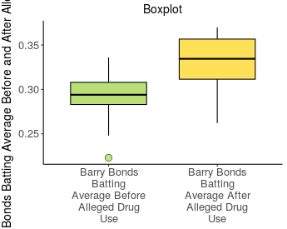
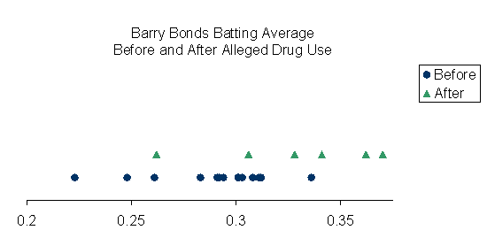
Barry Bonds Batting Average Hypothesis Test ..\Other Examples\Barry Bonds Batting Record.xlsx
Descriptive Statistics:
Group | Sample Size | Mean | Std. Dev.
Barry Bonds Batting Average Before Alleged Drug Use | 13 | 0.2895 | 0.0300
Barry Bonds Batting Average After Alleged Drug Use | 6 | 0.3282 | 0.0398

Slide 149
Barry Bonds Batting Average Hypothesis Test
Test Statistic:
Observed Difference | Standard Error | Test Statistic t
-0.0387 | 0.0183 | -2.119
Hypothesis Test:
Population Parameter | Null Hypothesis | Alternative Hypothesis | Test Statistic t | P-value
Difference μ₁ - μ₂ | μ₁ - μ₂ = 0 | μ₁ - μ₂ < 0 | -2.119 | 0.0340

Slide 150
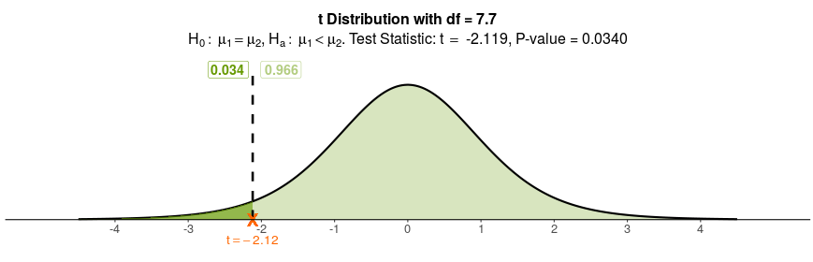
Barry Bonds Batting Average Hypothesis Test
Decision for Chosen Significance Level:
Decision
Reject H₀ because P-value of 0.0340 is less than 0.05

Slide 151
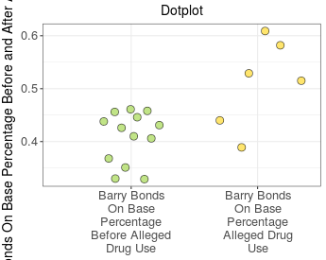
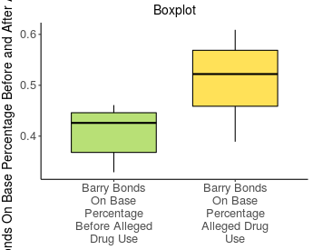
Barry Bonds On Base Percentage Hypothesis Test
Descriptive Statistics:
Group | Sample Size | Mean | Std. Dev.
Barry Bonds On Base Percentage Before Alleged Drug Use | 13 | 0.4085 | 0.0483
Barry Bonds On Base Percentage After Alleged Drug Use | 6 | 0.5107 | 0.0836

Slide 152
Barry Bonds On Base Percentage Hypothesis Test
Test Statistic:
Observed Difference | Standard Error | Test Statistic t
-0.1022 | 0.0366 | -2.789
Hypothesis Test:
Population Parameter | Null Hypothesis | Alternative Hypothesis | Test Statistic t | P-value
Difference μ₁ - μ₂ | μ₁ - μ₂ = 0 | μ₁ - μ₂ < 0 | -2.789 | 0.0143

Slide 153
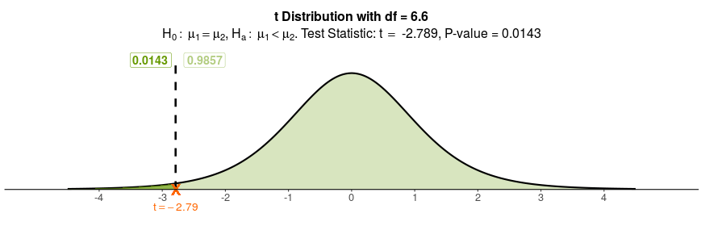
Barry Bonds On Base Percentage Hypothesis Test
Decision for Chosen Significance Level:
Decision
Reject H₀ because P-value of 0.0143 is less than 0.05

Slide 154
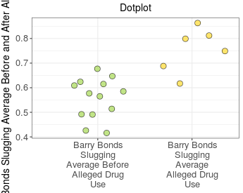
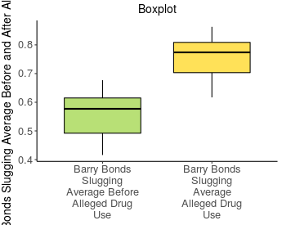
Barry Bonds Slugging Average Hypothesis Test
Descriptive Statistics:
Group | Sample Size | Mean | Std. Dev.
Barry Bonds Slugging Average Before Alleged Drug Use | 13 | 0.5568 | 0.0826
Barry Bonds Slugging Average After Alleged Drug Use | 6 | 0.7547 | 0.0899

Slide 155
Barry Bonds Slugging Average Hypothesis Test
Test Statistic:
Observed Difference | Standard Error | Test Statistic t
-0.1979 | 0.0433 | -4.575
Hypothesis Test:
Population Parameter | Null Hypothesis | Alternative Hypothesis | Test Statistic t | P-value
Difference μ₁ - μ₂ | μ₁ - μ₂ = 0 | μ₁ - μ₂ < 0 | -4.575 | 0.0007

Slide 156
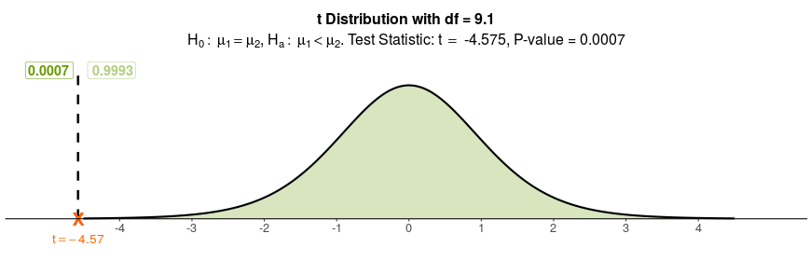
Barry Bonds Slugging Average Hypothesis Test
Decision for Chosen Significance Level:
Decision
Reject H₀ because P-value of 0.0007 is less than 0.05

Slide 157
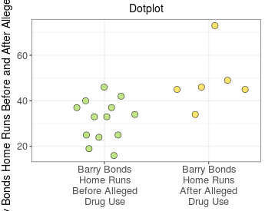
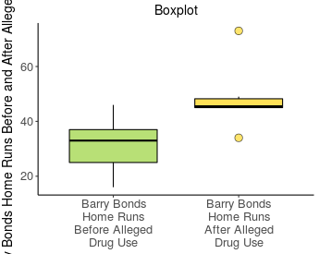
Barry Bonds Home Runs Hypothesis Test
Descriptive Statistics:
Group | Sample Size | Mean | Std. Dev.
Barry Bonds Home Runs Before Alleged Drug Use | 13 | 31.62 | 9.13
Barry Bonds Home Runs After Alleged Drug Use | 6 | 48.67 | 12.97

Slide 158
Barry Bonds Home Runs Hypothesis Test
Test Statistic:
Observed Difference | Standard Error | Test Statistic t
-17.05 | 5.87 | -2.905
Hypothesis Test:
Population Parameter | Null Hypothesis | Alternative Hypothesis | Test Statistic t | P-value
Difference μ₁ - μ₂ | μ₁ - μ₂ = 0 | μ₁ - μ₂ < 0 | -2.905 | 0.0108

Slide 159

Barry Bonds Home Runs Hypothesis Test
Decision for Chosen Significance Level:
Decision
Reject H₀ because P-value of 0.0108 is less than 0.05

Slide 160
Barry Bonds Hypothesis Tests
Barry Bonds Conclusion
Keep in mind that this article can’t state that Mr. Bonds did or did not take performance-enhancing drugs; it is an analysis of his performance before and after the alleged use.
The statistical analysis of the data shows that Mr. Bonds’ hitting performance increased in the years after he allegedly started using performance-enhancing drugs and furthermore, that it is extremely unlikely that this performance increase was random.
Is it possible that Mr. Bonds did not take performance-enhancing drugs? Yes. Assuming for the moment that he did not take the alleged drugs, did his performance still increase? Yes.
There is strong evidence to support that Mr. Bonds’ batting performance increased substantially from 1999 to 2004. If it wasn’t the use of performance-enhancing drugs, then some other assignable cause is likely to be responsible for his performance increase.

Slide 161

Examples: Roger Clemens
Roger Clemens Pitching Statistics Before and After Alleged Drug Use
 | Before (1984-1997) | After (1998-2005) | Chances of Getting it Wrong (Type I Error) | Conclusion
ERA (lower better) | 3.09 | 3.45 | 35% | No change in performance
Adjusted ERA+ (higher better) | 152 | 140 | 49% | No change in performance
WHIP (lower better) | 1.168 | 1.227 | 35% | No change in performance
Based upon the analysis of Roger Clemens’ ERA, Adjusted ERA+, and WHIP statistics, there is insufficient statistical evidence to suggest that his average performance changed in the years before and after the alleged use of performance-enhancing drugs.

Slide 162
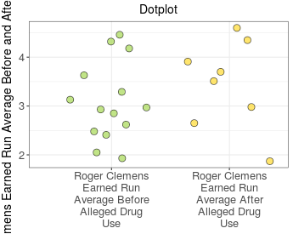
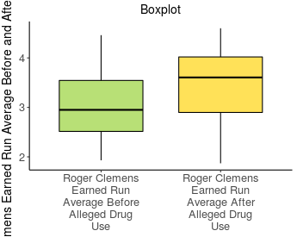
Roger Clemens Earned Run Average Hypothesis Test
Descriptive Statistics:
Group | Sample Size | Mean | Std. Dev.
Roger Clemens Earned Run Average Before Alleged Drug Use | 14 | 3.089 | 0.808
Roger Clemens Earned Run Average After Alleged Drug Use | 8 | 3.446 | 0.908

Slide 163
Roger Clemens Earned Run Average Hypothesis Test
Test Statistic:
Observed Difference | Standard Error | Test Statistic t
-0.357 | 0.387 | -0.923
Hypothesis Test:
Population Parameter | Null Hypothesis | Alternative Hypothesis | Test Statistic t | P-value
Difference μ₁ - μ₂ | μ₁ - μ₂ = 0 | μ₁ - μ₂ ≠ 0 | -0.923 | 0.3726

Slide 164
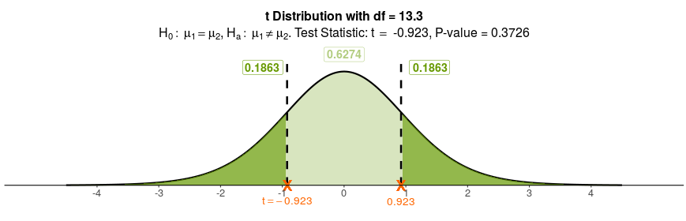
Roger Clemens Earned Run Average Hypothesis Test
Decision for Chosen Significance Level:
Decision
Fail to reject H₀ because P-value of 0.3726 is greater than 0.05

Slide 165
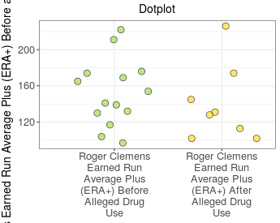
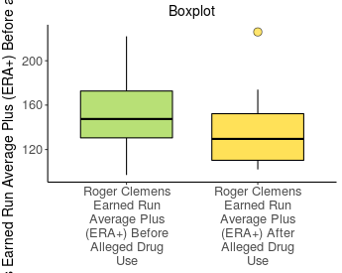
Roger Clemens Earned Run Average Plus (ERA+) Hypothesis Test
Descriptive Statistics:
Group | Sample Size | Mean | Std. Dev.
Roger Clemens Earned Run Average Plus (ERA+) Before Alleged Drug Use | 14 | 152.2 | 36.8
Roger Clemens Earned Run Average Plus (ERA+) After Alleged Drug Use | 8 | 140.1 | 42.1

Slide 166
Roger Clemens Earned Run Average Plus (ERA+) Hypothesis Test
Test Statistic:
Observed Difference | Standard Error | Test Statistic t
12.1 | 17.9 | 0.677
Hypothesis Test:
Population Parameter | Null Hypothesis | Alternative Hypothesis | Test Statistic t | P-value
Difference μ₁ - μ₂ | μ₁ - μ₂ = 0 | μ₁ - μ₂ ≠ 0 | 0.677 | 0.5100

Slide 167

Roger Clemens Earned Run Average Plus (ERA+) Hypothesis Test
Decision for Chosen Significance Level:
Decision
Fail to reject H₀ because P-value of 0.5100 is greater than 0.05

Slide 168


Roger Clemens Walks and His per Innings Pitched (WHIP) Hypothesis Test
Descriptive Statistics:
Group | Sample Size | Mean | Std. Dev.
Roger Clemens Walks & Hits per Innings Pitched Before Alleged Drug Use | 14 | 1.168 | 0.134
Roger ClemensWalks & Hits per Innings Pitched After Alleged Drug Use | 8 | 1.227 | 0.142

Slide 169
Roger Clemens Walks and His per Innings Pitched (WHIP) Hypothesis Test
Test Statistic:
Observed Difference | Standard Error | Test Statistic t
-0.0588 | 0.0618 | -0.951
Hypothesis Test:
Population Parameter | Null Hypothesis | Alternative Hypothesis | Test Statistic t | P-value
Difference μ₁ - μ₂ | μ₁ - μ₂ = 0 | μ₁ - μ₂ ≠ 0 | -0.951 | 0.3577

Slide 170

Roger Clemens Walks and His per Innings Pitched (WHIP) Hypothesis Test
Decision for Chosen Significance Level:
Decision
Fail to reject H₀ because P-value of 0.3577 is greater than 0.05

Slide 171
Roger Clemens Hypothesis Tests
Roger Clemens Conclusion
This analysis is limited in scope to Mr. Clemens’ performance in the years prior to and after alleged drug use.
I am sure many will argue that his performance should have dropped in his later years due to the natural effects of aging. In fact, Mr. Clemens’ performance did drop; however, the drop was not statistically significant and it appears that his performance before and after alleged drug use was approximately the same.
Is it possible that Mr. Clemens took performance-enhancing drugs? Yes. Assuming for the moment that he did take performance-enhancing drugs, did it increase his performance over previous years? No.
There is little, if any, evidence that Roger Clemens’ performance was increased in the years after the alleged use. Put another way, if Mr. Clemens did take performance-enhancing drugs, he should get his money back.

Slide 172

Designated Hitter Fetteroll Sample from ESPN.com Hypothesis Test
In baseball, the American League allows a Designated Hitter (DH) to bat for the pitcher, who is typically a weak hitter. In the National League, the pitcher must bat. The common belief is that this results in American League teams scoring more runs. In inter-league play, when American League teams visit National League teams, the pitcher must bat. So, if the DH does result in more runs, we would expect American League teams to score fewer runs when visiting National League parks.
To test this claim, a random sample of runs scored by American League teams with and without their DH is given in the following table: (ESPN.com) – note the year that this sample was drawn from is not recorded in Fettroll’s textbook.
You will test the claim that the DH results in more runs scored
Do a hypothesis test to test the claim that the DH results in more runs scored. Which test statistic will you use, t or z?

Slide 173



Designated Hitter Fetteroll Sample from ESPN.com Hypothesis Test
Descriptive Statistics:
Group | Sample Size | Mean | Std. Dev.
American League Teams in American League Parks | 30 | 5.97 | 3.55
American League Teams in National League Parks | 30 | 4.33 | 2.60

Slide 174
Designated Hitter Fetteroll Sample from ESPN.com Hypothesis Test
Test Statistic:
Observed Difference | Standard Error | Test Statistic t
1.633 | 0.803 | 2.033
Hypothesis Test:
Population Parameter | Null Hypothesis | Alternative Hypothesis | Test Statistic t | P-value
Difference μ₁ - μ₂ | μ₁ - μ₂ = 0 | μ₁ - μ₂ > 0 | 2.033 | 0.0235

Slide 175

Designated Hitter Fetteroll Sample from ESPN.com Hypothesis Test
Decision for Chosen Significance Level:
Decision
Reject H₀ because P-value of 0.0235 is less than 0.05

Slide 176



Designated Hitter 2019 Hypothesis Test
Descriptive Statistics:
Group | Sample Size | Mean | Std. Dev.
American League Teams in American League Parks | 155 | 4.37 | 2.94
American League Teams in National League Parks | 154 | 4.58 | 2.93

Slide 177
Designated Hitter 2019 Hypothesis Test
Test Statistic:
Observed Difference | Standard Error | Test Statistic t
-0.210 | 0.334 | -0.629
Hypothesis Test:
Population Parameter | Null Hypothesis | Alternative Hypothesis | Test Statistic t | P-value
Difference μ₁ - μ₂ | μ₁ - μ₂ = 0 | μ₁ - μ₂ > 0 | -0.629 | 0.7351

Slide 178

Designated Hitter 2019 Hypothesis Test
Decision for Chosen Significance Level:
Decision
Fail to reject H₀ because P-value of 0.7351 is greater than 0.05

Slide 179
Homework 10 - Statistical Inference
From Agresti, et. al.
Problem 9.70, Free throw accuracy, page 454
Problem 9.76, Start a hockey team, page 455
Problem 9.87,Tennis balls in control, page 456
Problem 9.99, Baseball home team advantage, page 457

Slide 180
Homework 10 - Statistical Inference
Let’s compare the runs per game for the 12 American League teams in 1972, which was the last year with no DH, and the runs per game for those same teams in the first year with the DH, 1973.The table below shows the runs per game for each team in 1972 and 1973.
RUNS PER GAME RUNS PER GAME
TEAM 1972 1973
Baltimore Orioles 3.37 4.65
Boston Red Sox 4.13 4.56
California Angels 2.93 3.88
Chicago White Sox 3.68 4.03
Cleveland Indians 3.03 4.20
Detroit Tigers 3.58 3.96
Kansas City Royals 3.77 4.66
Milwaukee Brewers 3.16 4.37
Minnesota Twins 3.49 4.56
New York Yankees 3.59 3.96
Oakland Athletics 3.90 4.68
Texas Rangers 2.99 3.82
(a) Explain how you know that these are paired data.
(b) Find the increase in the number of runs per game for each team for the two seasons.
(c) At the 0.05 significance level, test the null hypothesis that μ1 = μ2
(d) Does your hypothesis test give convincing evidence that teams in the AL had a greater ABILITY to score runs in 1973? Explain.

Slide 181


Homework 10 - Statistical Inference
Mark McGwire and Sammy Sosa both broke Roger Maris’ single season Home Run record of 60 in 1988.
Sosa finished with a .308 batting average, 66 home runs, and 158 RBI, besting McGwire, who finished with a .299 batting average, 70 home runs, and 147 RBI for the NL MVP award. The Cubs, however, were swept in the first round of the 1998 playoffs by the Atlanta Braves.

Slide 182
Homework 10 - Statistical Inference
The Sosa-McGwire home run chase occurred during the steroid era. Bonds' record still stands, though the controversy over possible use of performance-enhancing drugs by McGwire and Sosa gained momentum when Bonds hit his 73 home runs despite having never hit as many as 50 in any other season. In the Congressional Hearing on Steroids, McGwire stated that any answer he gave regarding his alleged steroid use would not be believed by the public at-large anyway. Sosa seemed to not understand the questions.
Bonds has also been linked to steroids. He admitted to taking them, but he claims that he did not know what he was taking was steroids. Bonds and Sosa have been linked to illegal use of steroids in the Mitchell Report and other sources. McGwire has never been named by any official investigation; however, on January 11, 2010, McGwire admitted to Bob Costas of the MLB Network that he did take steroids throughout his career, including during the 1998 season where he broke the record.

Slide 183
Homework 10 - Statistical Inference
Perform the same before-and-after alleged drug use hypothesis tests for McGwire and Sosa that we did for Bonds, i.e. test the null Hypotheses that µ1 = µ2 versus µ1 < µ2 for Batting Average, Home Runs, Slugging Average and On-Base-Percentage.
For McGwire use the years 1987-1992 as the “before” years and 1995-2001 as the “after” years. We omit 1993 and 1994 because McGwire was injured for most of the games in those years. In 1997, he was traded from Oakland to St. Louis so there are two separate lines in the spreadsheet for that year. He was injured again in 2000 and 2001 and only played a little over half a year in each of them. So, for our purposes combine 2000 and 2001 into one year. This will give us 6 “before” years and 7 “after” years for our hypothesis tests.
Using the same logic for Sosa, use 1990-1994 as his “before” years. Combine 1991 and 1992 into one year. Use 1995-2004 as his “after” years. This will give us 4 “before’ years and 10 “after” years.
When combining two years into one, pro-rate the data. So, for McGwire for 2000 and 2001, multiply his 2000 numbers by 89/(89+97)= 0.478 and multiply his 2001 numbers by 97/(89+97)= 0.522 and add them together to create a ‘single’ year’s statistics. For Sosa, in 1991 and 1992, use 116/(116+67)= 0.634 and 67/(116+67) = 0.366.

Slide 184
Extra Slides
Notes:
184

Slide 185
Problem 9.18 Opinions on Fracking a year earlier, page 406
Let p be the proportion of the population that opposes increased use of fracking. H₀ : p = 0.5 and H_{α} : p = 0.5.
pˆ = 740 /1506 = 0.491; The standard error is
√p₀ ( 1 – p₀)/ n = √0.5 ( 1 – 0.5)/ 1506 = 0.0129
so z = (0.491 – 0.5) / 0.0129 = -0.670. the sample
proportion of 0.491 is less than one standard error less than
the null hypothesis value of 0.50.
c) The P-value is 0.251. Because the P-value is larger than the significance level of 0.05, we do not reject the null hypothesis. There is no evidence from the survey that in 2013 those opposing fracking are in the minority. The probability would be 0.251 of getting a test statistic at least as extreme as the value observed if the null hypothesis were true, and the population proportion were 0.50.

Slide 186
Problem 9.18 Opinions on Fracking a year earlier, page 406 (continued)
d) np₀ = n(1-p₀) = 1506(0.5) = 735≥15; The sample of 1506 respondents must be a random sample representative of the U.S. population in 2013 (which it was).
e) The P-value for the two-sided alternative is 2(0.251) = 0.502.

